Slide 1
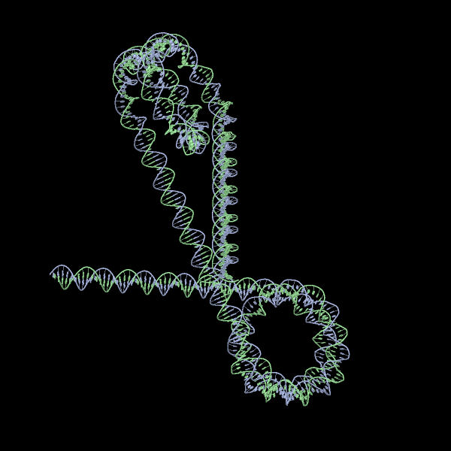
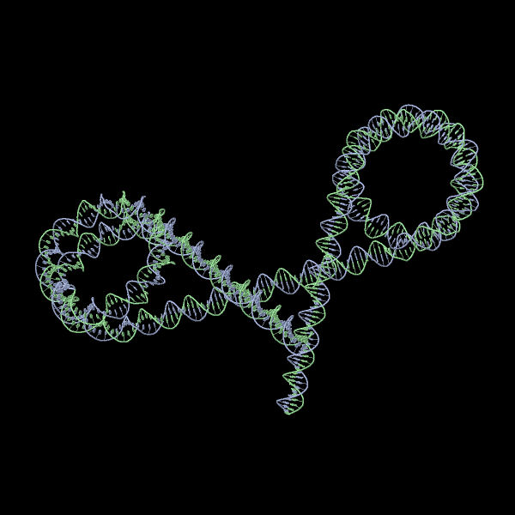
DIMACS REU
Research Project on Chromatin Folding & DNA Looping
Alexandria Volkening
Images from w3dna

Slide 2
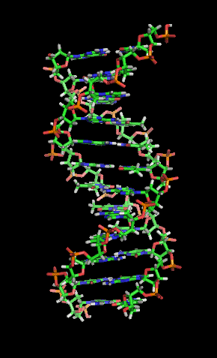
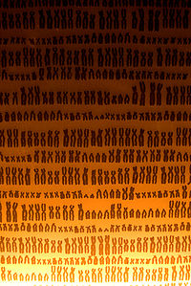
Background: The Genome
Each of the 10 trillion cells in the human body contains a copy of the same genome
This genome consists of 2 meters of DNA which must be compacted to fit into small nuclei
DNA is often modeled as a linear construction, but this popular representation is only the beginning of the story
Images from Wikipedia

Slide 3
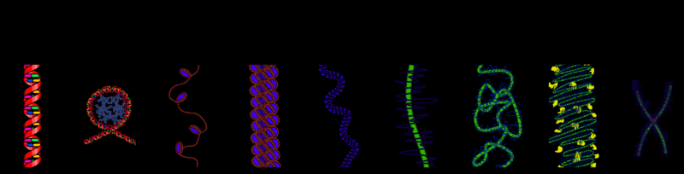
The Genome: Continued
The double helix wraps around sets of 8 proteins called histones
Image from Wikipedia
These protein-DNA spools, or nucleosomes, are the heart of the cell’s packaging system
The DNA then bends further with the help of more proteins until it takes on the shape of a familiar chromosome
Nicholas Wade (2009). “From One Genome, Many Types of Cells. But How?”. The New York Times.

Slide 4
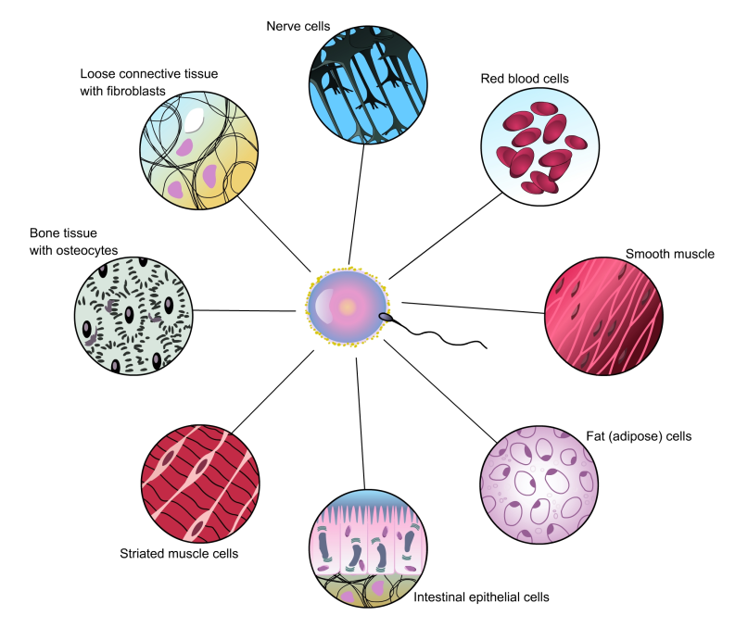
Background: The Epigenome
Because the cells of the body differ in essence and function, a second code of instructions other than the genes themselves must be at work
Scientists are beginning to realize that nucleosomes are much more than passive packaging units
Image from http://219.221.200.61/ywwy/zbsw(E)/pic/ech12-2.jpg
In fact, the histones combine with other epigenetic markers and proteins to form a second level of hereditary information: the epigenome
The epigenome helps determine what genes a cell has access to an when it has access to them, and is thus directly involved in cell differentiation
Nicholas Wade (2009). “From One Genome, Many Types of Cells. But How?”. The New York Times.

Slide 5
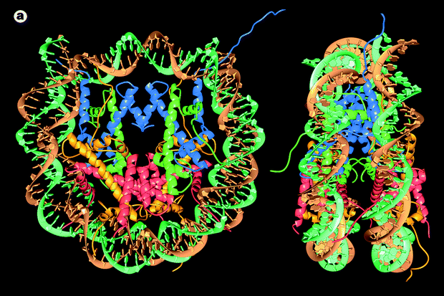
The Epigenome: Continued
Epigenetics is a new subject of study and may influence aging and cancer treatments
The epigenome lies at the intersection of a person’s genome and his environment
K. Luger et al (1997). “Crystal structure of the nucleosome core particle at 2.8 A resolution.” Nature, Vol. 389.
Thus, it could hold answers to the question of why identical twins may look different or experience different diseases as they grow older
Nicholas Wade (2009). “From One Genome, Many Types of Cells. But How?”. The New York Times.

Slide 6
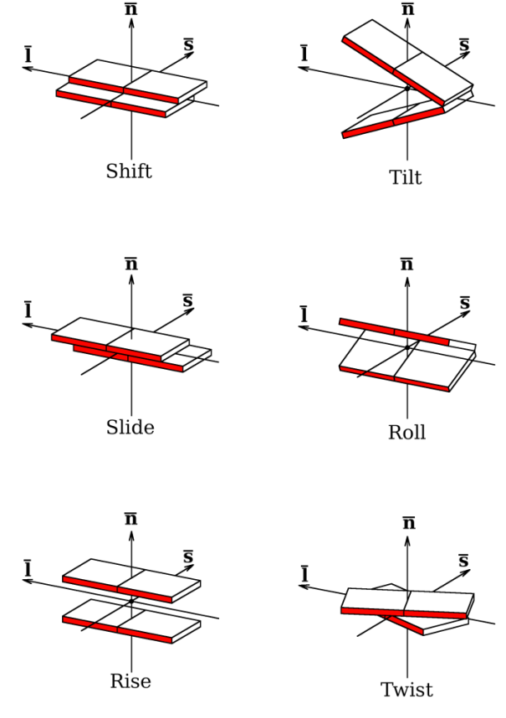
My Research Project
Given: A DNA sequence and the observed probabilities that nucleosomes occur at different sites along it
To create: A Monte-Carlo simulation (random number generator) that assigns nucleosomes to up to 9 places on the strand based on the probabilities observed
To characterize: The topology of the DNA structures geometrically
To generate: A set of data that describes the relationship between adjacent base pairs using 12 parameters
To build: 3D structures via w3dna and the data generated by my program
Image from: L. Britton, W. Olson, I. Tobias. “Two Perspectives on the Twist of DNA.”

Slide 7
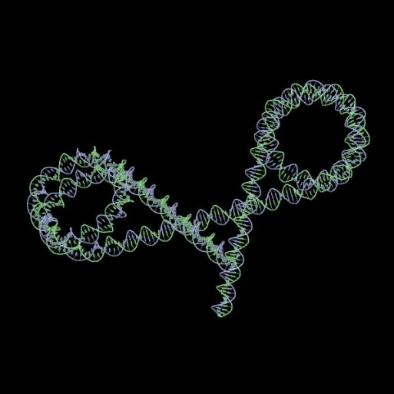
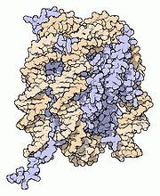
Examples & Acknowledgements
Examples:
Example Parameters File
Image from w3dna
Image from w3dna
http://w3dna.rutgers.edu/
Acknowledgements:
Dr. Wilma Olson
Guohui Zheng
Mauricio Esguerra
Lauren Britton
Image from Wikipedia
Questions?

