Slide 1
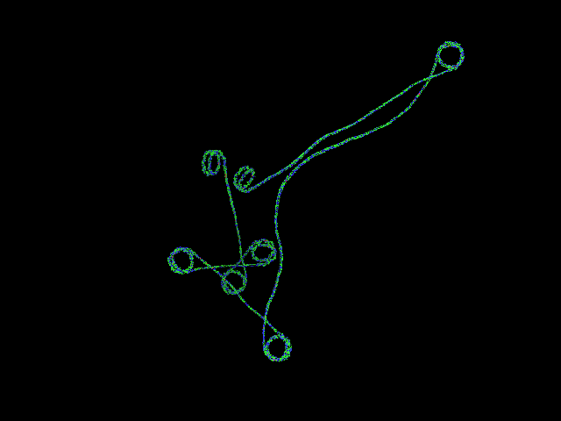
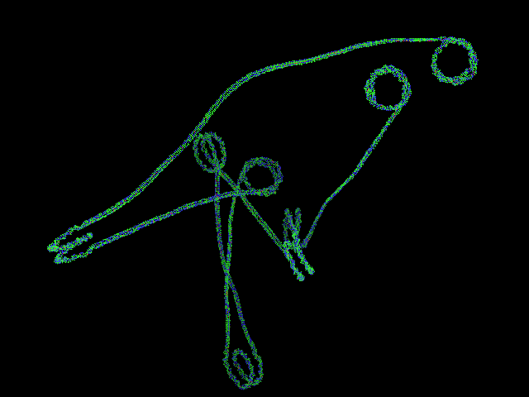
DIMACS REU
Research Project on Chromatin Folding & DNA Looping
Alexandria Volkening
Images generated using Pymol

Slide 2
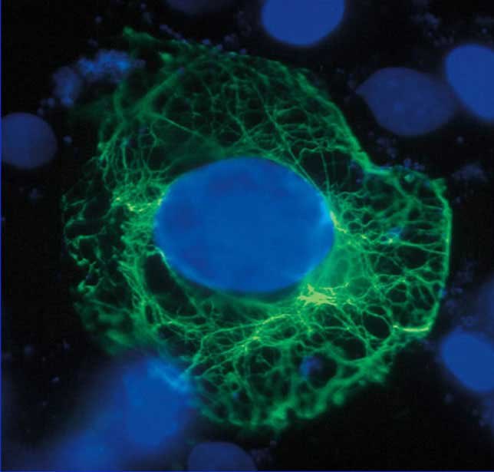
Introduction
Each of the 10 trillion cells in the human body contains a copy of the same genome.
The average cell nucleus is 0.005mm in diameter, but must hold 2m of DNA.
Cells fit the entire genome into their nuclei through the help of proteins which fold and bend the DNA upon itself, forming compact loops and coils of genetic information.
Image taken from the National Institute for Medical Research at
http://www.nimr.mrc.ac.uk/virology/doorbar/function/fig2/

Slide 3
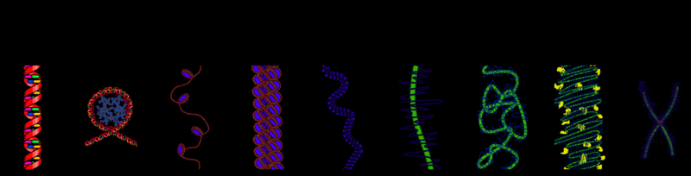
Introduction: Continued
Proteins affect the 3D shape of DNA ribbons at many levels, but scientists have recently begun to realize that these proteins are much more than just passive packaging units.
Image from Wikipedia
Some proteins regulate gene expression by controlling a cell’s access to its DNA, and play a key role in cell differentiation.
Protein-DNA interactions, like those in nucleosomes, comprise a second level of hereditary information: the epigenome.
The epigenome lies at the intersection of a person’s genome and his environment and promises to influence many areas, including cancer treatment and aging.
Nicholas Wade (2009). “From One Genome, Many Types of Cells. But How?”. The New York Times.

Slide 4
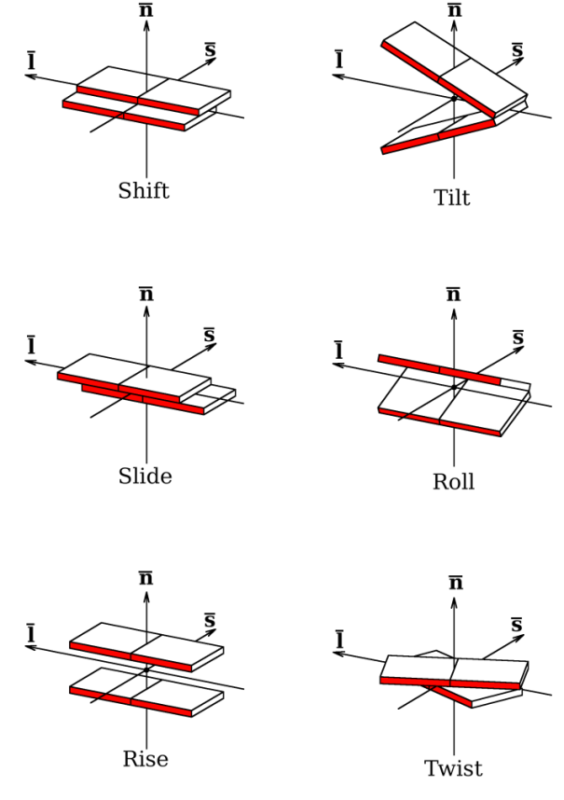
My Research Project
Given: A DNA sequence and the observed probabilities that nucleosomes occur at different sites along it.
To create: A Monte-Carlo (i.e. stochastic) simulation that assigns nucleosomes to up to 8 places on the strand based on the probabilities observed.
To characterize: The topology of the DNA structures geometrically.
To generate: A set of data that describes the relationship between adjacent base pairs using 12 parameters.
To build: 3D structures via w3dna and the data generated by my program.
To analyze: The topological features of closed DNA loops in detail.
Image from: L. Britton, W. Olson, I. Tobias. “Two Perspectives on the Twist of DNA.”

Slide 5
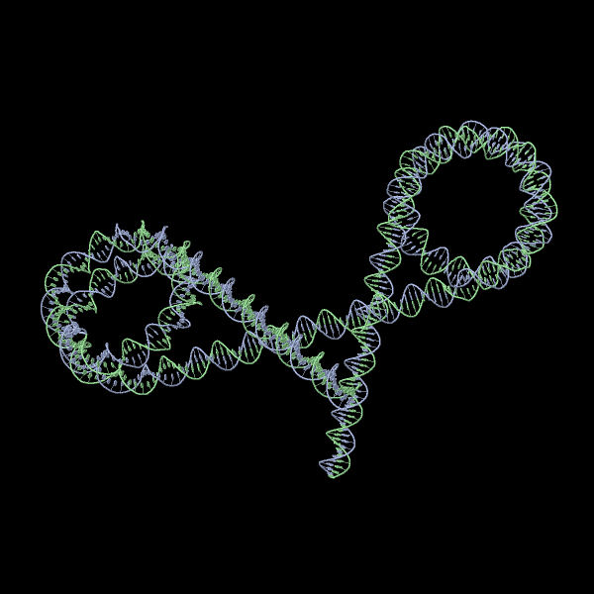
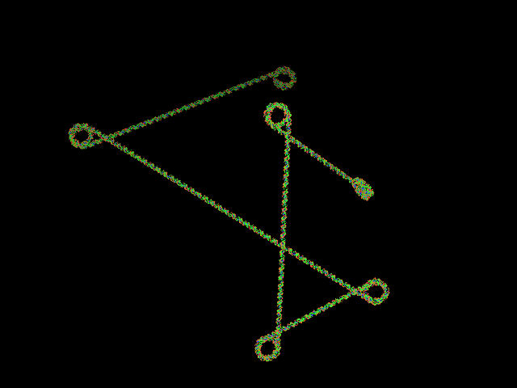
Research Results
I first assembled a test structure using Excel to create a list of parameters by hand given a
short DNA sequence and nucleosome positions.
Image generated using w3dna
After attempting to program in Matlab, I switched to Python for its ease of string handling.
My program stochastically simulates how the positioning of nucleosomes along a DNA strand affects the gene’s topology as expressed in the relations between adjacent bases and base-pairs.
Images generated using Pymol
In constructing the formatted output file, several
functions were used which matched base pairs and established the right geometric parameters for the strand depending on whether or not the portion in question held a nucleosome.

Slide 6
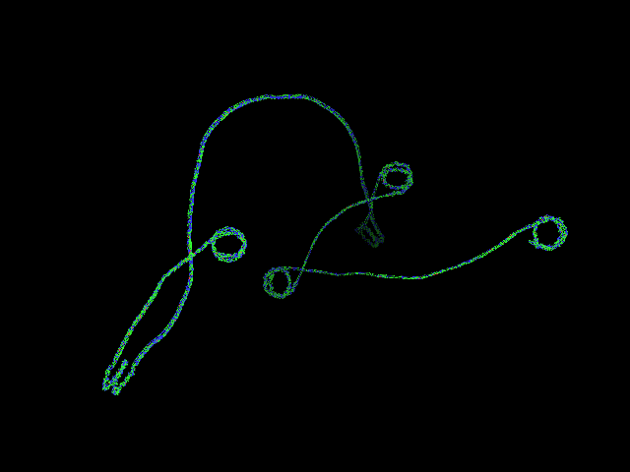

Research Results: Continued
Version #1 of my program worked under the assumption that free (ie.
unbounded) DNA is perfectly straight, but this is not actually the case.
I took this into account in my second version by generating parameters for the free DNA using a Gaussian distribution of random numbers rather than by reading off a set of preconceived parameters from a file.
Images generated using Pymol
In the final version of my program, I added it on to a shell script written by Lauren Britton. This enabled me to run my program 5000 times and simultaneously rebuild my parameter files into 3D images using existing software.

Slide 7
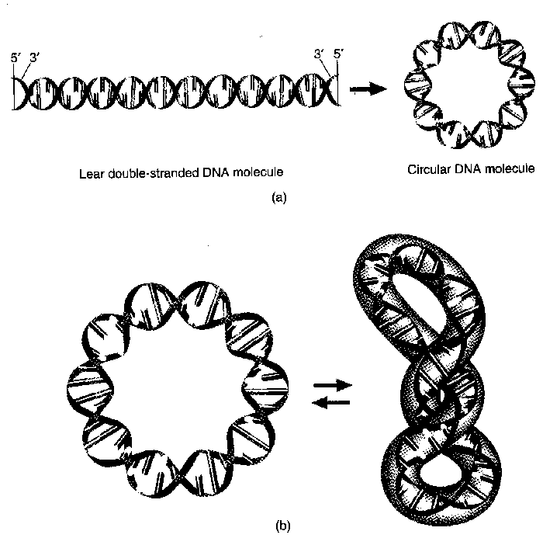
New Directions: Ribbon Theory
Proteins are known to close DNA strands into loops at times.
Such structures are of specific interest because they have topological invariants associated with them.
The linking number, Lk, is equal to the number of crossings between the 2 backbones of the double helix.
The Lk value is preserved unless the DNA loop is broken via a protein.
Comparing a DNA strand to a ribbon, we can introduce 2 more topological quantities: twist (Tw) & writhe (Wr).
Tw has to do with how much a ribbon twists around its axis, and Wr is related to DNA supercoiling or the curve of the strand’s axis in space.
Lk = Tw + Wr
Taken from http://members.tripod.com/arnold_dion/RecDNA/notes.html

Slide 8

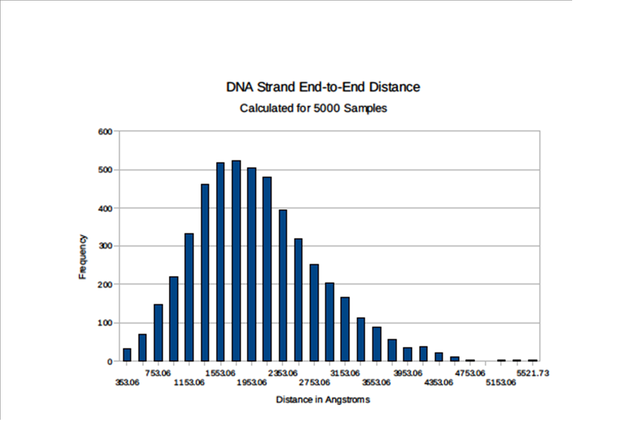
Research Results: New Directions
Using a program already built into the script shell,
I expressed my original parameter files as
xyz-coordinates for each base-pair in the DNA strand.
Image
generated
using Pymol
I then wrote a program to calculate the distance
between the ends of each strand.
In the future, my program could be used to generate more samples in search of closed loop structures.

Slide 9
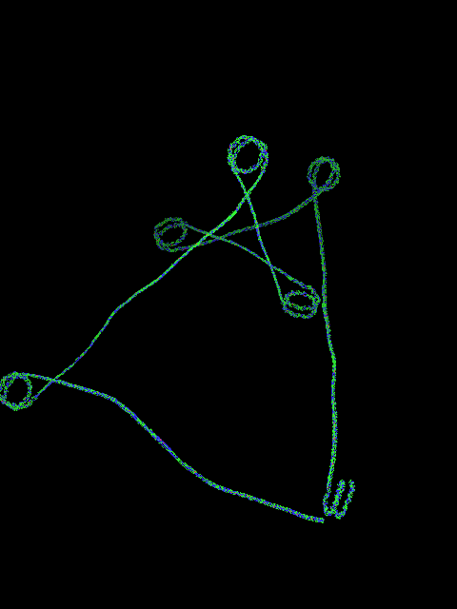
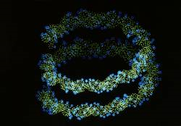
Acknowledgements
With Special Thanks To:
Dr. Wilma Olson
Gohui Zheng
Image generated using Pymol
Lauren Britton
Mauricio Esguerra
Image taken from the LBNL Image Library at http://acs.lbl.gov/ImgLib/COLLECTIONS/BERKELEY-LAB/RESEARCH-1991-PRESENT/LIFE-SCIENCES/index/96703490.html

