Slide 1
A Computational Model of Visual Impairments in Individuals With Schizophrenia
Orren Ravid under supervision of P.I. Prof. Konstantinos Michmizos

Slide 2
The Problem
Certain visual impairments have been found and studied in individuals with schizophrenia.
As of now, no proposed mechanism has given a completely satisfactory explanation for why these particular impairments occur in individuals with schizophrenia.

Slide 3
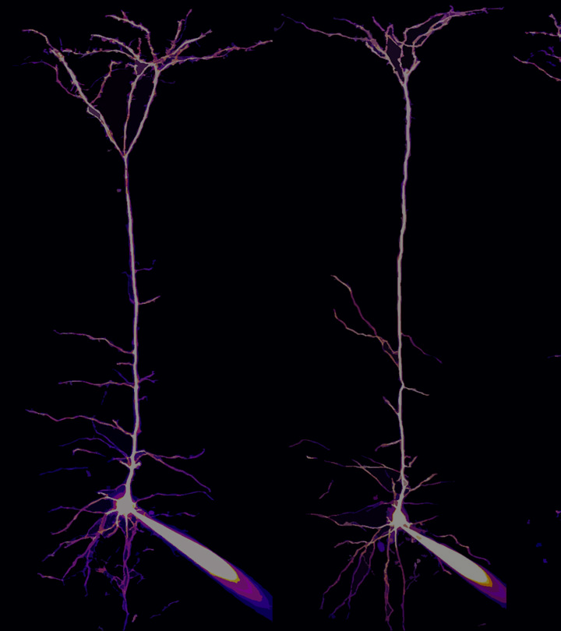
A Proposed Mechanism
One possible mechanism that has recently been studied in neurons in the human neocortex is apical amplification (AA).

Slide 4
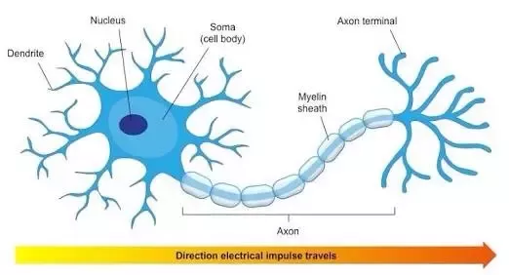
A Quick Aside: Neurons
Biological neurons consist generally of three parts: a soma (cell body), dendrites, and an axon.
The dendrites of a neuron take in input from other neurons through synapses.
Then, the soma integrates these synaptic inputs and converts them to a change in somatic voltage.
If this voltage exceeds a certain threshold, then an electrical impulse called an action potential propagates down the axon to reach the dendrites of other neurons.

Slide 5
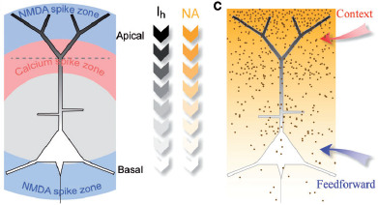
Apical Amplification
Some neurons, such as V5 pyramidal neurons in the human neocortex or CA1 neurons in the hippocampus, have two separate compartments for integrating input- the basal dendrites and the apical dendrites.
When a certain threshold of input is reached at the apical compartment, this results in the amplification of the input to the basal compartment.
It is postulated that apical inputs provide contextual awareness to the sensory inputs that are received at the basal compartment.

Slide 6
Apical Amplification and Schizophrenia
The abnormal expression of particular genes may be responsible for inhibiting the propagation of apical inputs to the basal dendrites and therefore disrupting apical amplification.
This would lead to decreased contextual awareness and therefore a decreased ability to use contextual knowledge when interpreting sensory inputs.

Slide 7

What does this mean for vision?
Context is extremely important for how we process visual stimuli.
Our interpretation of the purpose and placement of a particular detail of an image is strongly dependent on its surroundings and background.

Slide 8
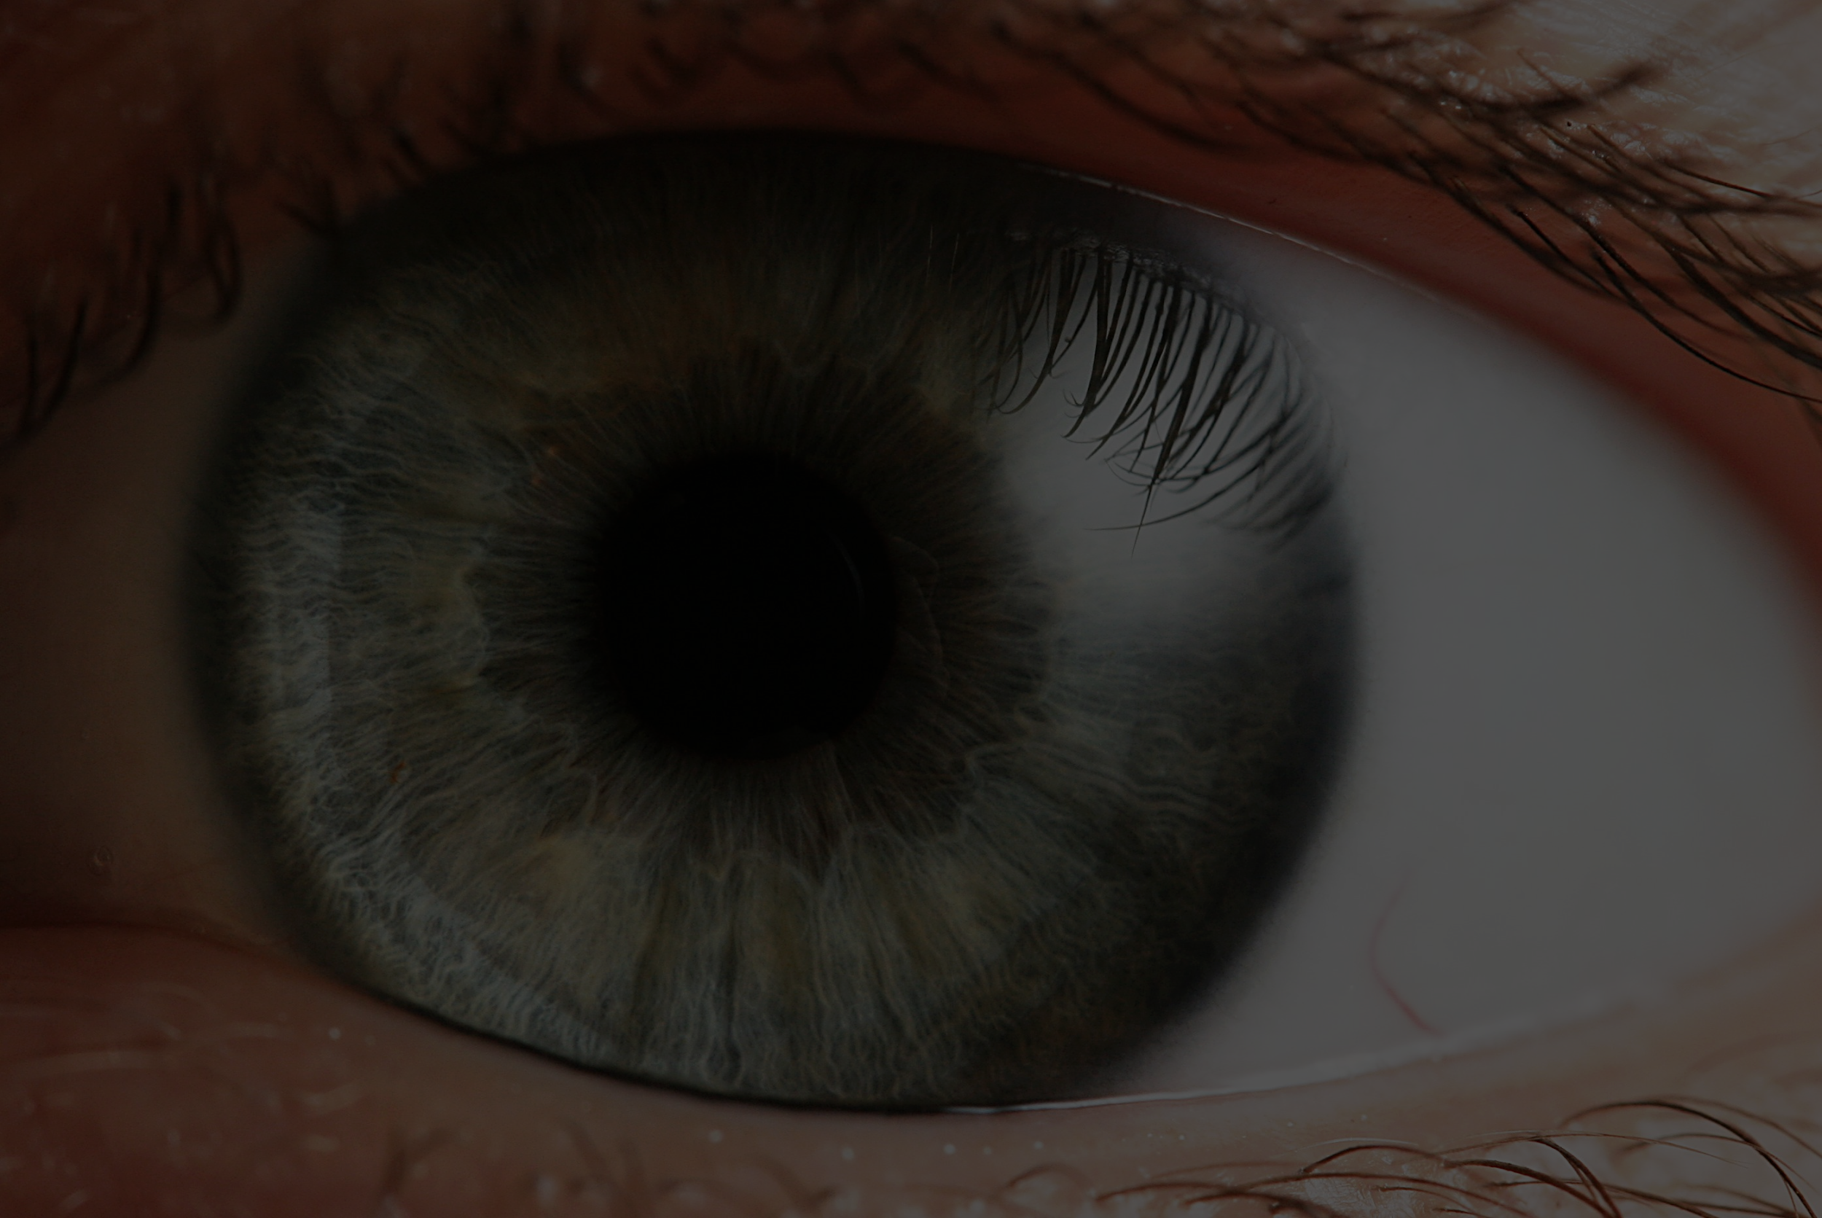
The Goal:
A Computational Model of AA + Visual Learning Task

Slide 9
Reaching The Goal
Make a computational model of AA
Apply it to a visual learning task
Modify the parameters of the model so its response is similar to that found in schizophrenia
Produce a model that correctly uses apical amplification in a visual learning task and then modify the parameters in a way that mimics the behavior found in schizophrenia.

Slide 10
Important Considerations
What degree of biological plausibility do we need for our model of a neuron in order to have enough complexity and flexibility to mimic the aberrant behavior that occurs in schizophrenia?
Is apical amplification alone mechanistically robust enough to describe the visual impairments we find in schizophrenia or will we need a conjunction of mechanisms for our model to plausibly reproduce these behaviors?

Slide 11
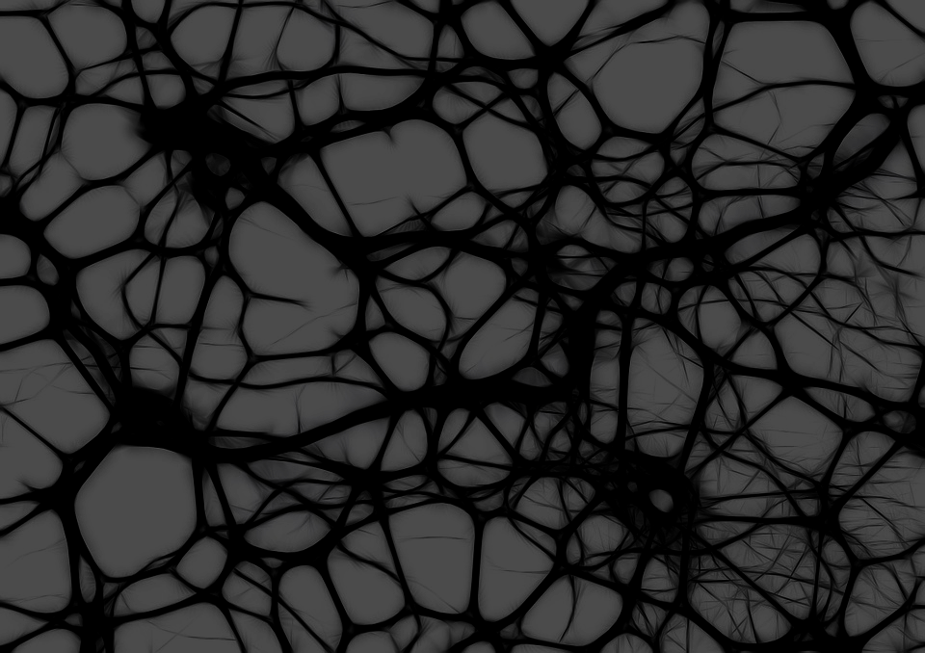
Acknowledgements
This project is supported by funding from NSF grant CCF-1852215

Slide 12
Sources
Phillips, W A et al. “The effects of arousal on apical amplification and conscious state.” Neuroscience of consciousness vol. 2016,1 niw015. 11 Sep. 2016, doi:10.1093/nc/niw015
Silverstein, Steven M., and Richard Rosen. “Schizophrenia and the Eye.” Schizophrenia Research: Cognition, vol. 2, no. 2, 7 Apr. 2015, pp. 46–55., doi:10.1016/j.scog.2015.03.004.

