Slide 1
Brain-inspired algorithm for controlling a robot
By Yianni Karabatis mentored by
Dr. Konstantinos Michmizos

Slide 2
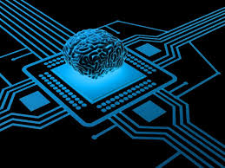
Background on Neuromorphic Computing
Most brain-derived part of AI
Brain-inspired computer chips
Artificial Neural Networks are not running on hardware best optimized for them
  Solution: Neuromorphic hardware
Neurons in neuromorphic computing communicate using synapses
  Post synaptic neuron gets activated
  Allows for more possibilities than 0 or 1
Allows for increased speed, complexity and computation at a lower energy cost

Slide 3
My Task/Methods
Develop a spike-based impedance controller run on neuromorphic chips for a robot
  Both hardware and software will mimic how the brain solves problems
  Impedance control: controlling the force of resistance from external environmental motion
    ratio of force output to motion input
    Used to send commands to a robot to prevent it from being over-manipulated by an external agent
      Vehicle safety
      Rehabilitation Robotics
    Concept invented by Dr. Neville Hogan
      Dr. Michmizos’ post-doc advisor at MIT
  Achieved via Spiking Neural Network

Slide 4


Slide 5
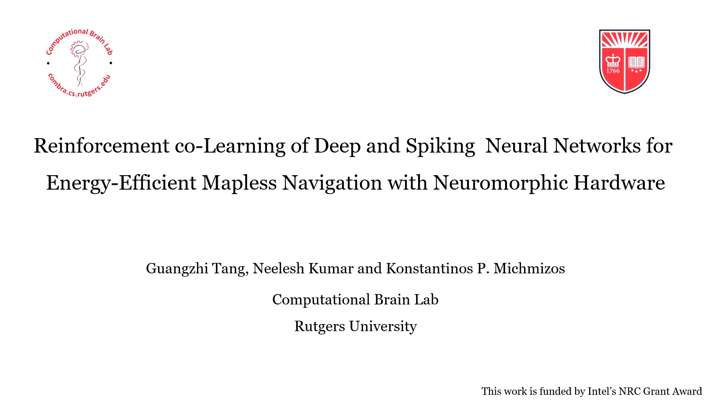

Slide 6
Sources
Grollier, Julie. [Department de Physique de l’ENS]. (2020, January 15). J. Grollier - Neuromorphic computing: overview and challenges. [Video]. https://www.youtube.com/watch?v=yfnJqVHmJEw&t=922s
G. Tang, N. Kumar, K.P. Michmizos, "Reinforcement co-Learning of Deep and Spiking Neural Networks for Energy-Efficient Mapless Navigation with Neuromorphic Hardware," submitted.
G Tang, A Shah, K.P. Michmizos, "Spiking neural network on neuromorphic hardware for energy-efficient unidimensional SLAM," 2019 IEEE/RSJ International Conference on Intelligent Robots and Systems (IROS), Macau, China, Nov 4-8, 2019.
Hogan, Neville. [Hannes Hoeppner]. (2012, April 10). Talk on “Robotic Interaction Control for Contact Robotics” by Neville Hogan Part1. [Video]. https://www.youtube.com/watch?v=GjKy3EFs3g8&t=1567s

Slide 7
Acknowledgement
DIMACS REU program
NSF grant CCF-1852215
Dr. Michmizos
Combra lab for input on this presentation

