Slide 1
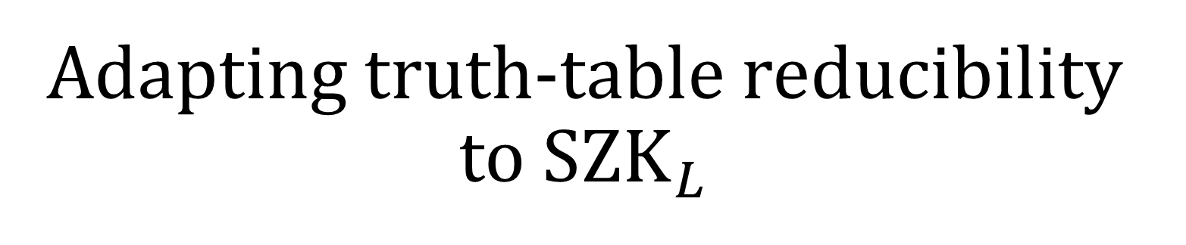
Adapting truth-table reducibility to $SZK_{L}$
Jacob Gray
Work done with coauthors Eric Allender, Saachi Mutreja, Harsha Tirumala, and Pengxiang Wang
Done as part of the 2022 DIMACS REU at Rutgers University

Slide 2
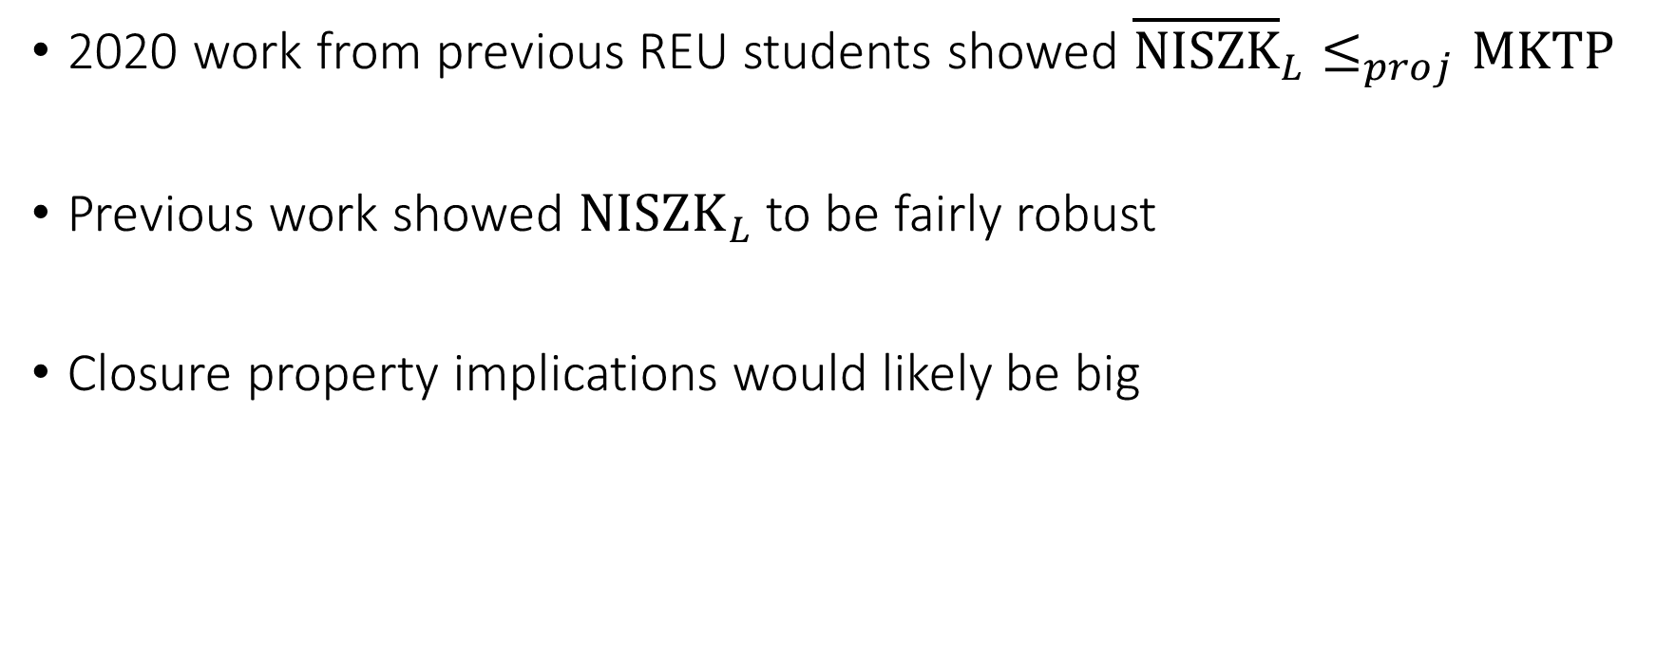
Reasons for studying
2020 work from previous REU students showed ${\overline{NISZK}}_{L}≤_{proj}MKTP$
Previous work showed $NISZK_{L}$ to be fairly robust
Closure property implications would likely be big

Slide 3

Interactive proof systems
Proof system for a promise problem $Π$:
Verifier and prover exchange messages:
Bounded verifier
Unbounded prover
Verifier accepts if convinced by the given “proof”

Slide 4
Zero-knowledge intuition
Premise: don’t reveal additional information during proof
The verifier can “predict” or compute prover’s response beforehand

Slide 5
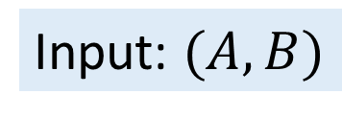
Zero-knowledge example
Example: “Are these two graphs non-isomorphic?”
Input: $(A, B)$
C = A or B, chosen randomly
Bounded verifier
Unbounded prover
Random permutation of C
Guess of what C is

Slide 6
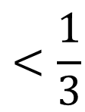

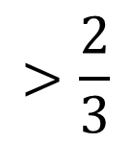
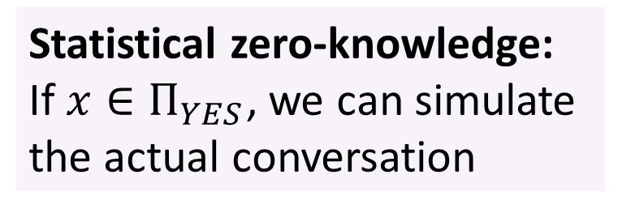
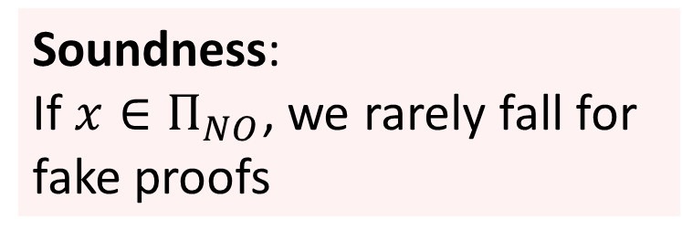
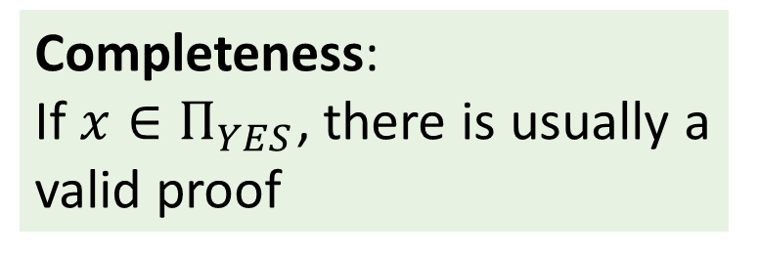
The statistical zero-knowledge proof model
Completeness:
If $x∈Π_{YES}$, there is usually a valid proof
$$>\frac{2}{3}$$
Soundness:
If $x∈Π_{NO}$, we rarely fall for fake proofs
Distribution of proofs for $x∈Π_{YES}$
$$<\frac{1}{3}$$
Statistical zero-knowledge:
If $x∈Π_{YES}$, we can simulate the actual conversation

Slide 7

















Distributions
Circuits
Distributions as circuits! (and branching programs)
$$∨$$
$$∧$$
$$∨$$
Uniformly random input
$$b_{1}$$
$$b_{2}$$
$$b_{3}$$
$$b_{4}$$
$$C$$
Branching programs
$$b_{2}$$
$$b_{3}$$
$$b_{4}$$
$$1$$
$$b_{1}$$
$$b_{2}$$
$$b_{3}$$
$$b_{4}$$
$$0$$

Slide 8
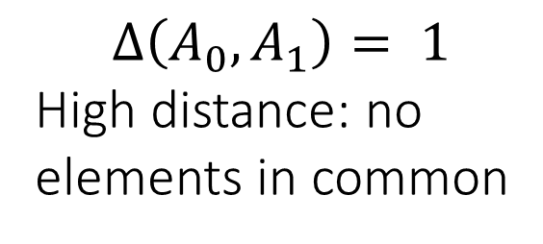
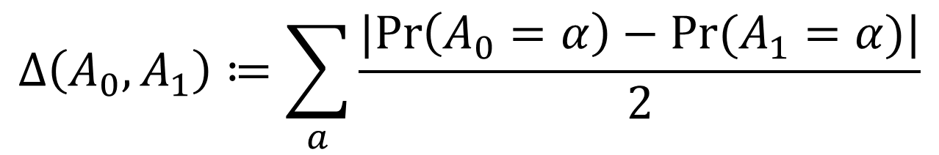
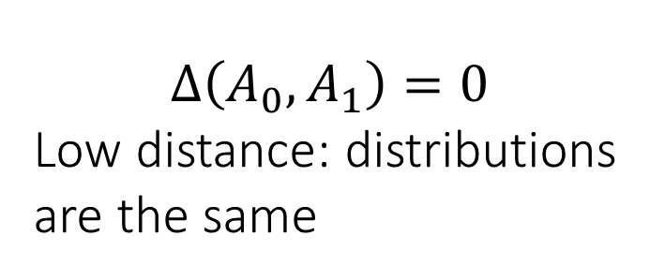
Statistical difference
$$Δ\left(A_{0}, A_{1}\right)≔\sum_{a}{\frac{|Pr\left(A_{0}=α\right)−Pr⁡(A_{1}=α)|}{2}}$$
$$Δ\left(A_{0}, A_{1}\right)=0$$
Low distance: distributions are the same
$$Δ\left(A_{0}, A_{1}\right)= 1$$
High distance: no
elements in common

Slide 9


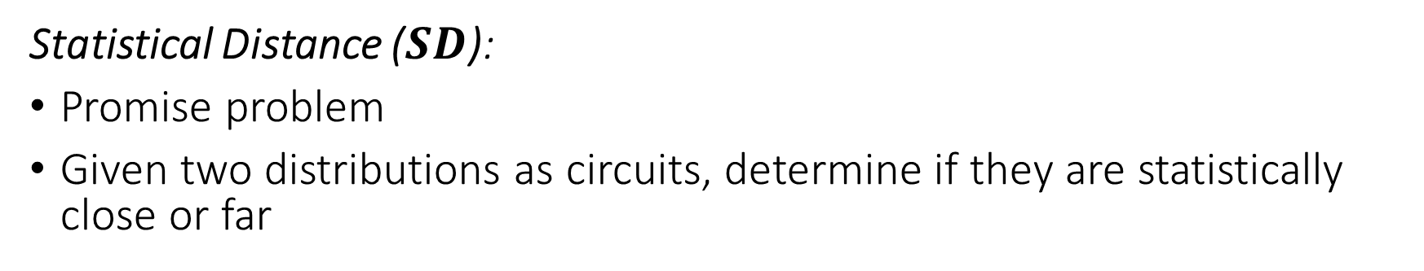


Complete problems for SZK
Statistical Distance ($SD$):
Promise problem
Given two distributions as circuits, determine if they are statistically close or far
Far distributions
Close distributions
or
$$x∈SD_{YES}$$
$$x∈SD_{NO}$$
$$Distance >2/3$$
$$Distance<1/3$$

Slide 10

$SZK$ Properties
Closure under complementation
Closure under (formula) truth table reductions
Can make proof system exponentially secure in size of input
Trivially contains BPP, also contains some cryptographic problems (discrete log)

Slide 11


${SZK}_{L}$Definition
Logspace verifier and simulator
Complete problem is $SD$, but now with branching programs
Many previous properties hold over from SZK

Slide 12



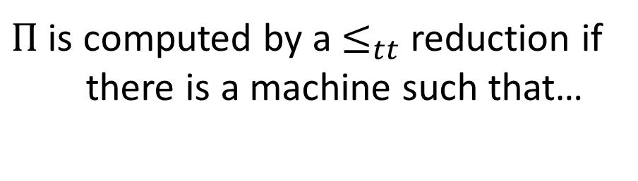





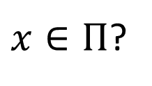


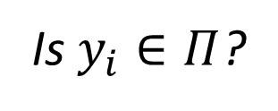

Truth table reductions
In our context:
$Π$ is computed by a $≤_{tt}$ reduction if
there is a machine such that…
$$x$$
Reduction machine
Queries
Circuit
$$y_{1}$$
$$y_{2}$$
$$…$$
$$y_{n}$$
$$C$$
Is $y_{i}∈Π$?
$$C$$
Input bits:
$$b_{1}$$
$$b_{2}$$
$$…$$
$$b_{n}$$
$x∈Π$?

Slide 13
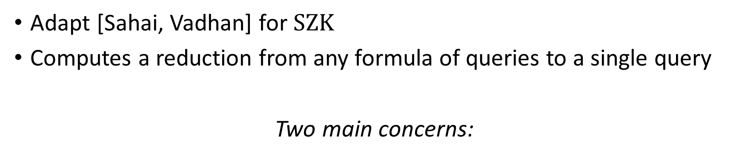
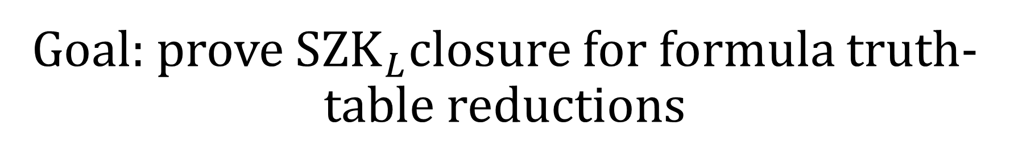
Goal: prove $SZK_{L}$closure for formula truth-table reductions
Adapt [Sahai, Vadhan] for $SZK$
Computes a reduction from any formula of queries to a single query
Two main concerns:
Branching programs
Circuits
Polynomial time
Logspace

Slide 14



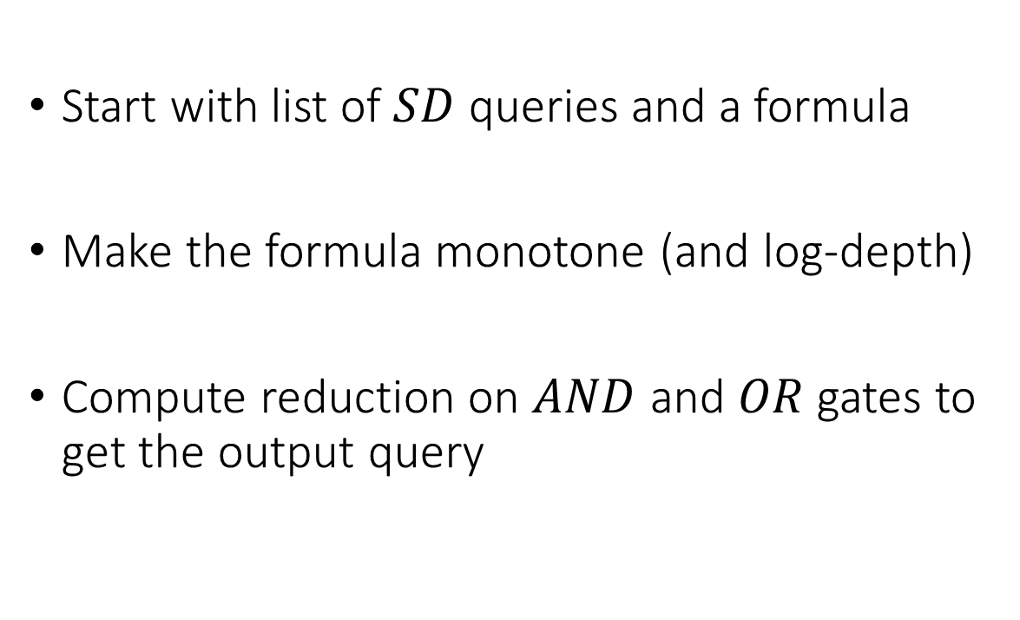


Idea: compute a reduction
Start with list of $SD$ queries and a formula
Make the formula monotone (and log-depth)
Compute reduction on $AND$ and $OR$gates to get the output query
Queries
$$y_{1}$$
$$y_{2}$$
$$…$$
$$y_{n}$$
$${ F}_{0}$$
$${ F}_{1}$$

Slide 15





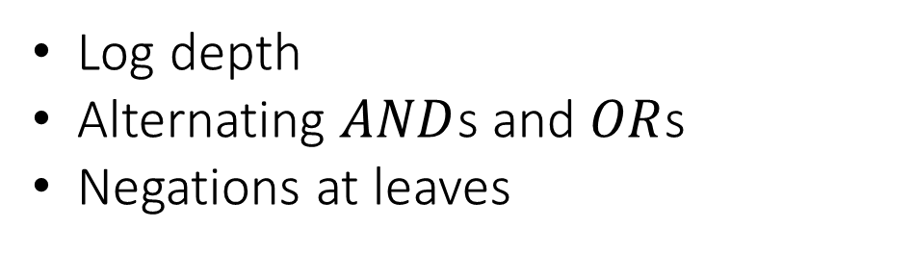










Creating the new formula
$$∨$$
Arbitrary formula:
$$¬$$
$$∧$$
Assume each variable only appears once
$$∨$$
$${ b}_{3}$$
$${ b}_{4}$$
$${ b}_{1}$$
$${ b}_{2}$$
New formula:
$$∨$$
Log depth
Alternating $AND$s and $OR$s
Negations at leaves
$$∧$$
$$∧$$
$${ \overline{b}}_{1}$$
$${ \overline{b}}_{2}$$
$${ b}_{3}$$
$${ b}_{4}$$

Slide 16









Computing $OR$ query
Original queries:
$${ P}_{0}$$
$${ P}_{1}$$
$${ Q}_{0}$$
$${ Q}_{1}$$
Query 1
Query 2
New query:
$${ P}_{0}$$
$${ Q}_{0}$$
$${ P}_{1}$$
$${ Q}_{1}$$
Query 1
Query 2

Slide 17











Computing $AND$ query
Original queries:
$${ P}_{0}$$
$${ P}_{1}$$
$${ Q}_{0}$$
$${ Q}_{1}$$
Query 1
Query 2
New queries:
$${ P}_{1}$$
$${ Q}_{1}$$
$${ P}_{1}$$
$${ Q}_{0}$$
$$b_{1}$$
$${ b}_{2}$$
$${ P}_{0}$$
$${ Q}_{0}$$
$${ P}_{0}$$
$${ Q}_{1}$$
Random$b_{1}, b_{2}$

Slide 18
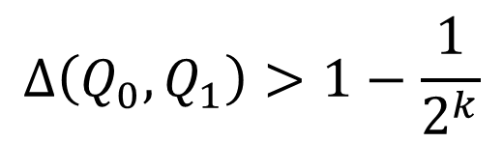
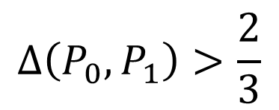
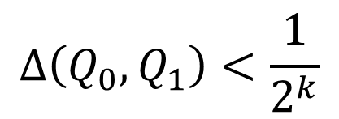
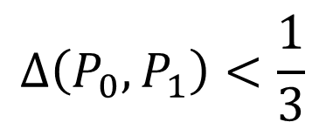
Polarization
Can use AND operation push far distributions farther
Can use OR operation to push close distributions closer
Alternate to get exponentially far or close distributions
$$Δ\left(P_{0}, P_{1}\right)>\frac{2}{3}$$
$$Δ\left(Q_{0}, Q_{1}\right)>1−\frac{1}{2^{k}}$$
$$Δ\left(P_{0}, P_{1}\right)<\frac{1}{3}$$
$$Δ\left(Q_{0}, Q_{1}\right)<\frac{1}{2^{k}}$$

Slide 19









Computing the output query (not really…)
Output query
$${ F}_{0}$$
$${ F}_{1}$$
For polynomial time, recursively compute and output
Non-trivial with logspace
$$∨$$
$$∧$$
$$∧$$
$${ \overline{b}}_{1}$$
$${ \overline{b}}_{2}$$
$${ b}_{3}$$
$${ b}_{4}$$

Slide 20











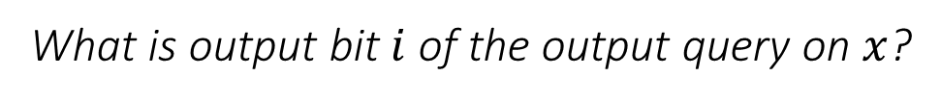
Tracing down the tree
What is output bit $i$ of the output query on $x$?
$${ F}_{0}$$
$${ F}_{1}$$
Bit $i$ of $F_{0}:$
Each output bit is copied from the output of some base query
$$∨$$
Compute by Logspace machine, then by BP
$$∧$$
$$∧$$
$${ \overline{b}}_{1}$$
$${ \overline{b}}_{2}$$
$${ b}_{3}$$
$${ b}_{4}$$
$a$ output bits

Slide 21
Computing the reduction:
Verifier and prover run the query machine
Compute the reduction to the single query
Do the proof system on that single query
Queries
$$y_{1}$$
$$y_{2}$$
$$…$$
$$y_{n}$$
$${ F}_{0}$$
$${ F}_{1}$$

Slide 22

Future closure properties?
Closure under general truth-table reductions?
$SREN$ properties?
$NISZK$ closure properties?

Slide 23
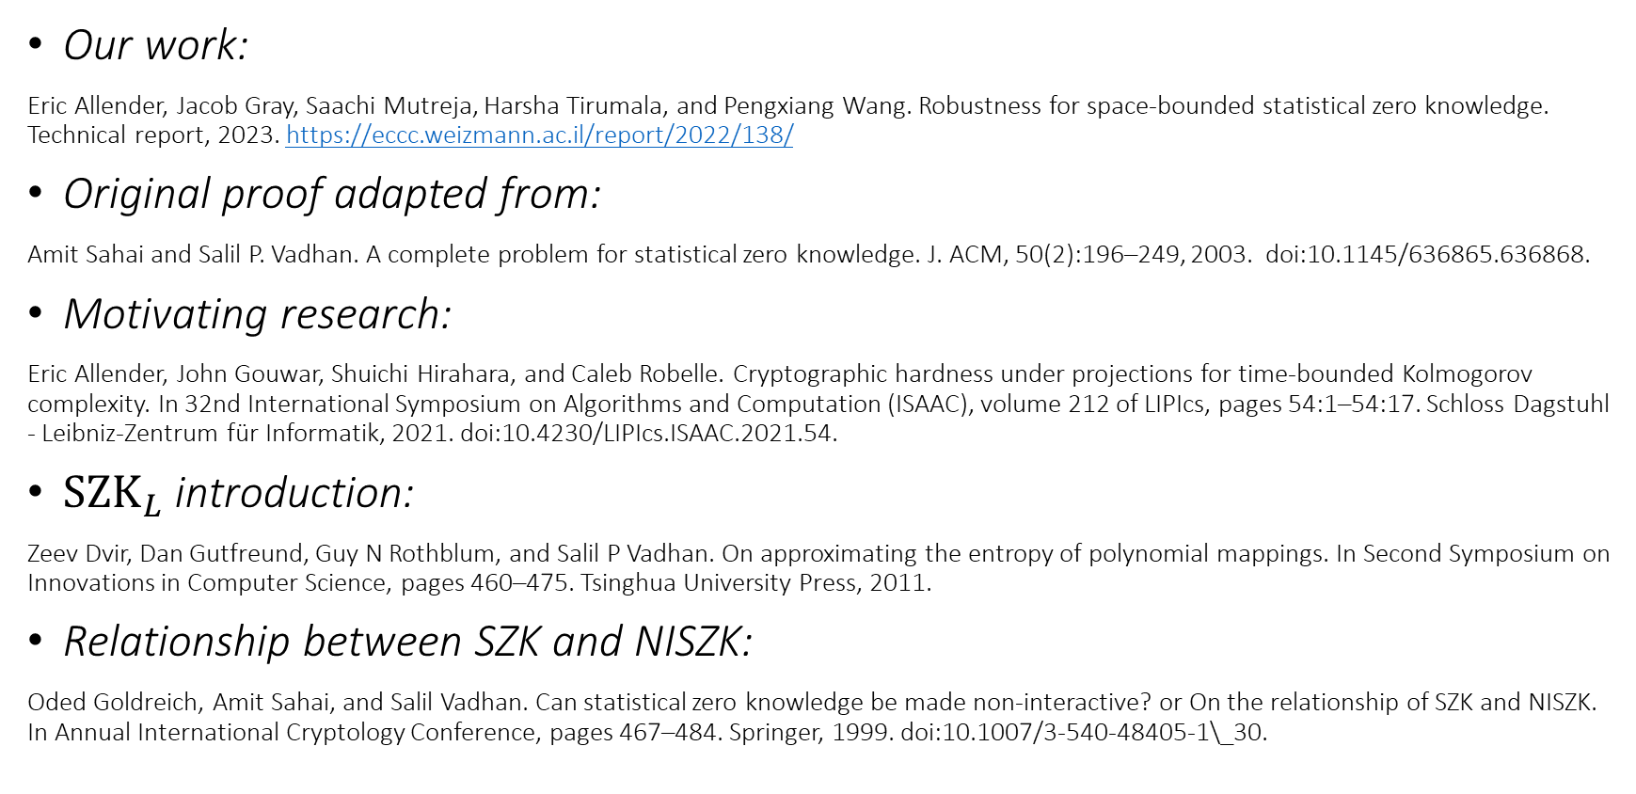
References
Our work:
Eric Allender, Jacob Gray, Saachi Mutreja, Harsha Tirumala, and Pengxiang Wang. Robustness for space-bounded statistical zero knowledge. Technical report, 2023. https://eccc.weizmann.ac.il/report/2022/138/
Original proof adapted from:
Amit Sahai and Salil P. Vadhan. A complete problem for statistical zero knowledge. J. ACM, 50(2):196–249, 2003. doi:10.1145/636865.636868.
Motivating research:
Eric Allender, John Gouwar, Shuichi Hirahara, and Caleb Robelle. Cryptographic hardness under projections for time-bounded Kolmogorov complexity. In 32nd International Symposium on Algorithms and Computation (ISAAC), volume 212 of LIPIcs, pages 54:1–54:17. Schloss Dagstuhl - Leibniz-Zentrum für Informatik, 2021. doi:10.4230/LIPIcs.ISAAC.2021.54.
$SZK_{L}$ introduction:
Zeev Dvir, Dan Gutfreund, Guy N Rothblum, and Salil P Vadhan. On approximating the entropy of polynomial mappings. In Second Symposium on Innovations in Computer Science, pages 460–475. Tsinghua University Press, 2011.
Relationship between SZK and NISZK:
Oded Goldreich, Amit Sahai, and Salil Vadhan. Can statistical zero knowledge be made non-interactive? or On the relationship of SZK and NISZK. In Annual International Cryptology Conference, pages 467–484. Springer, 1999. doi:10.1007/3-540-48405-1\_30.

Slide 24
Acknowledgements
Thanks to my coauthors Eric Allender, Saachi Mutreja, Harsha Tirumala, and Pengxiang Wang for helping me during and after the REU.
Thank you to Dave Barrington and Rik Sengupta for writing my letters of recommendation for the DIMACS REU program.
Thank you to DIMACS and the people at Rutgers for giving me the opportunity to do this work.

Slide 25

Other results during REU
Verifier and Simulator power
${NISZK}_{L}=NISZK_{AC^{0}}$
${NISZK}_{L}={NISZK}_{PM}$

Slide 26
NISZK Details
NI: Non-interactive
One-way communication, prover to verifier
Both have access to shared, uniformly random “reference string”
Modified complete problems – SDU and EA

Slide 27


$NISZK_{L}$ Closure differences
Complete problem – ${SDU}_{{NC}^{0}}$ and $EA_{NC^{0}}$
Deal with single circuits
Not clear how to adapt pairs of distributions to just one distribution

Slide 28
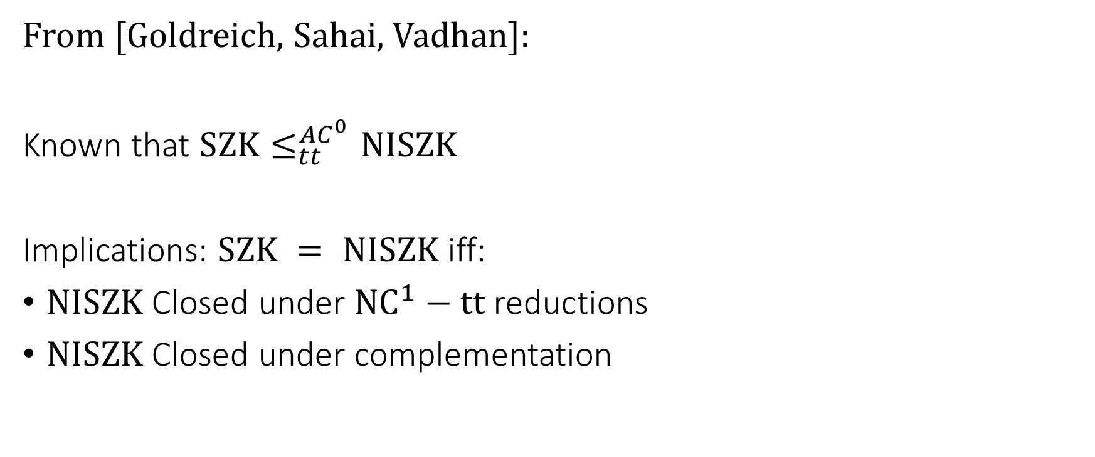
Relationships between NISZK and SZK
From [Goldreich, Sahai, Vadhan]:
Known that $SZK≤_{tt}^{AC^{0}}NISZK$
Implications: $SZK = NISZK$ iff:
$NISZK$ Closed under $NC^{1}−tt$ reductions
$NISZK$ Closed under complementation

Slide 29




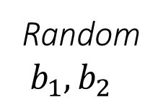







Computing $AND$ query (Extra)
Original queries:
$${ P}_{0}$$
$${ P}_{1}$$
$${ Q}_{0}$$
$${ Q}_{1}$$
Query 1
Query 2
New query:
Random$b_{1}, b_{2}$
$$b_{1}$$
$$b_{2}$$
$${ P}_{0}$$
$${ Q}_{0}$$
$${ P}_{1}$$
$${ Q}_{1}$$
$${ P}_{0}$$
$${ Q}_{1}$$
$${ P}_{1}$$
$${ Q}_{0}$$
Query 1
Query 2

