Slide 1
Truth Learning in a Social Setting
Jordan Chong and Matt Lu
Mentor: Professor Jie Gao
This work was carried out while the authors Jordan Chong and Matt Lu were participants in the 2023 DIMACS REU program at Rutgers University, supported by NSF HDR TRIPODS award CCF-1934924

Slide 2

Social Interactions and the Spread of Information
People make decisions often weighing their own private information and the public actions of those around them
Social media and the internet can lead to lots of information dissemination

Slide 3


Herding/Information cascades
People are influenced by the actions of others
An information cascade happens when people disregard their own information and follow the crowd
  Think trends, domino effect, sheep mentality
Notes:
Bring back urn experiment

Slide 4
Our Leading Questions
How can someone decipher what is true or not?
Does the order people make decisions matter?
Maximize the amount of people who know the truth

Slide 5
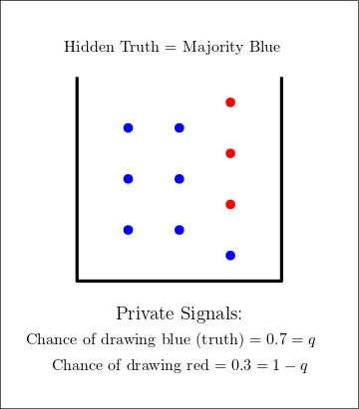
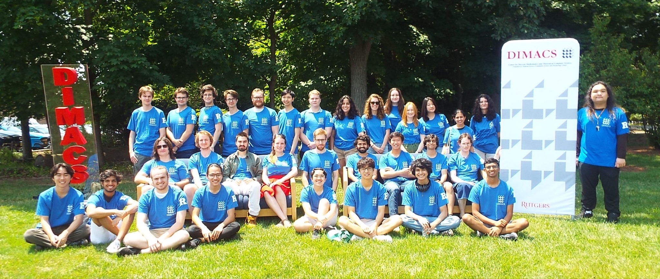
Hidden Ground Truth and Private Signals

Slide 6



Ordering and Actions
Red!
Red!
Red!

Slide 7
Goal: Maximize Learning Quality
We want the proportion of correct responses to be close to 1
Blue!

Slide 8
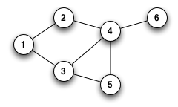
Using Graphs
Idea: Nodes are people (agents) and edges are connections in a social network
Social Connection
(edge)
Agent (node)
Notes:
How can we optimize the learning process of people so they correctly choose the better option?
Nodes are people and edges are connections between people (agents) in a social network
People receive a private signal with probability (p) indicating the better option and (1-p) indicating the worse option
People can also see the actions of any of their neighbors in the graph who have acted already
Combining the information they have of the actions of their neighbors with their private signal, we want the proportion of correct choices to be as close to 1 as possible

Slide 9
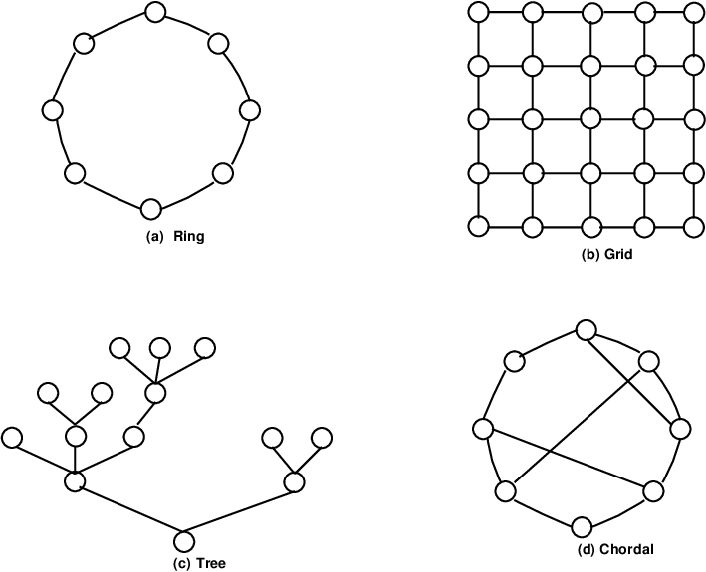
Maximizing Learning Quality: Model Ingredients
What are the parameters?
Topology
Ordering

Slide 10
Local Visibility
  Majority Rule using private signal and neighbors’ actions
Global Visibility
  Complex calculation using private signal, neighbors’ actions, graph structure and ordering

Slide 11
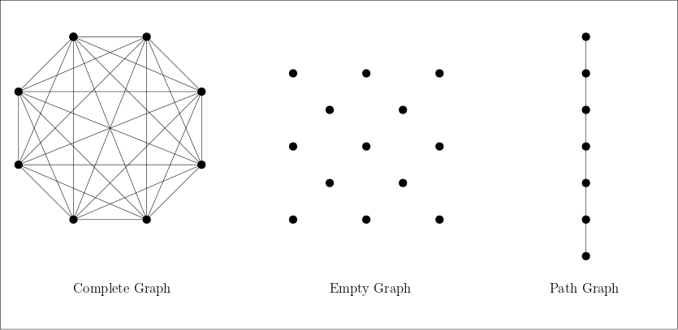
Ordering and Graph Topology: A Balancing Act
Notes:
Animation for path graph

Slide 12
Overview of Results
Table 1: Our results for different topologies and orderings
Topology | Characterization | Ordering | Bounds
Preferential attachment | High degree, high value | Aggregation-dissemination | Approaches 1?
Connected caveman | Low degree | Sequential | Bounded away from 1
n x n grid | Low degree | Spiral | Approaches 1?
Note: We use local visibility as the decision mechanism for all the above

Slide 13
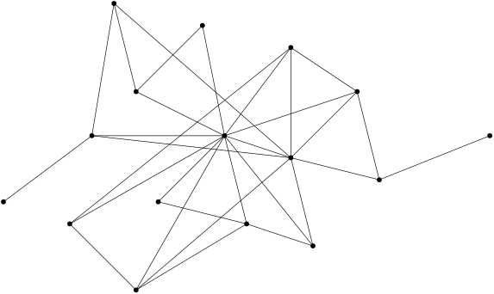
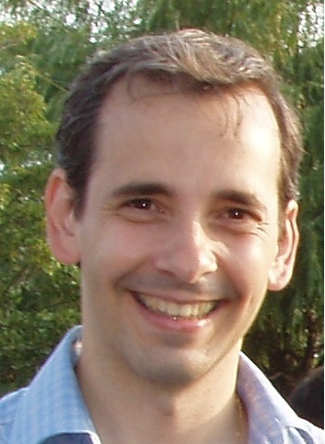
Preferential Attachment: Aggregation-dissemination
High-value node

Slide 14
Simulation results
Table 2: Comparison of preferential attachment network learning rate under random ordering and aggregation ordering over 500 trials, n=300, q=0.7
 | Random ordering | Aggregation ordering
Avg. Learning rate | 0.937 | 0.951
Neg. cascades | 17 | 2
Avg. indep. decisions | 19.06 | 31.82
Note: Negative cascades refer to the number of trials where the learning rate of the network is < q

Slide 15
Results
Table 1: Our results for different topologies and orderings
Topology | Characterization | Ordering | Bounds
Preferential attachment | High degree, high value | Aggregation-dissemination | Approaches 1?
Connected caveman | Low degree | Sequential | Bounded away from 1
n x n grid | Low degree | Spiral | Approaches 1?
Note: We use local visibility as the decision mechanism for all the above

Slide 16
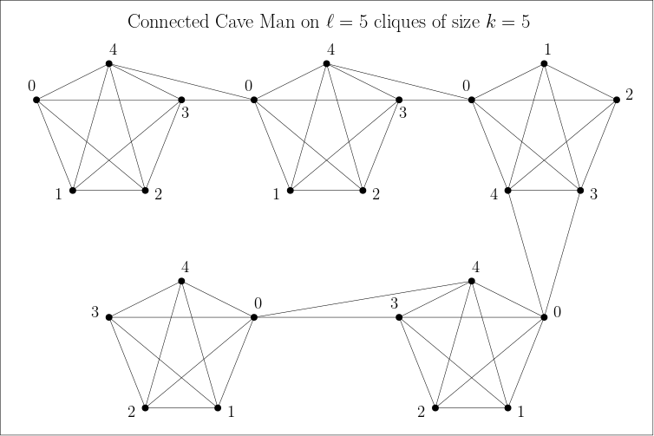
Connected Caveman
Graph of cliques with two edges connected adjacent cliques
Strategically choosing two edges to propagate information without cascades
Induce a sequential ordering

Slide 17
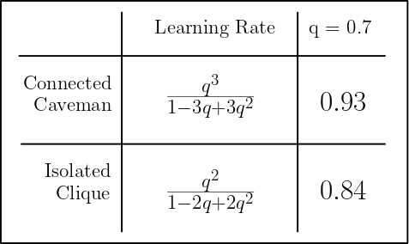
Learning Rate of Connected Caveman

Slide 18
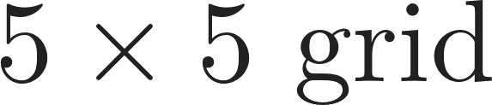

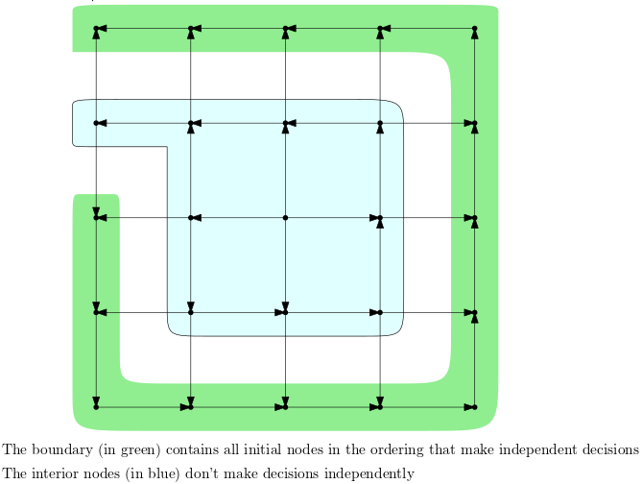
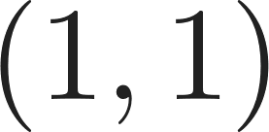

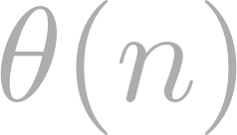
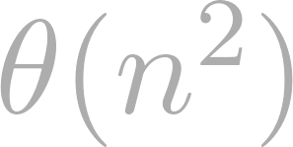
Grid
grid
We induce a spiral ordering starting from (1,1) to the center of the grid
As , the size of the boundary nodes increase in and the interior nodes increase in

Slide 19
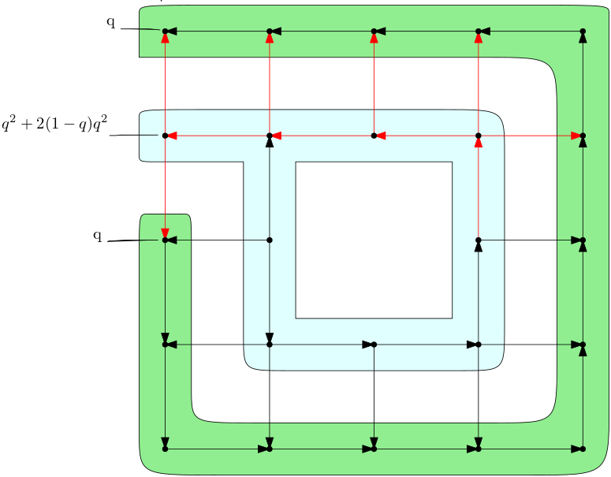

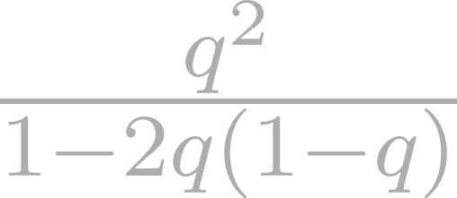
Learning rate for grid
The boundary nodes all learn successfully with probability
In the second layer, the learning rate from node to node increases monotonically (non-corners)
The learning rate in the second layer converges to

Slide 20
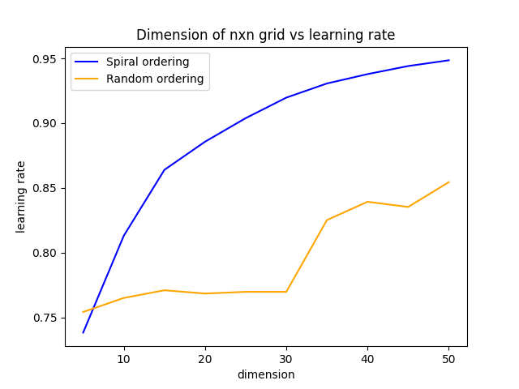
Learning rate converges to 1?
Size of grid vs learning rate
n

Slide 21
Future Direction
Low degree graphs with learning rate approaching 1?
NP hardness of ordering for general case?
Global visibility model?
Thank you for listening!

