Slide 1
Brad Greening
Rutgers University
Duration of Infectivity and Disease in Dynamic Networks
Bobby Zandstra
Florida Gulf Coast University
Long- vs. Short-term Friendships and the Spread of Disease
Mentor: Prof. Nina Fefferman
Presentation Date: July 17, 2008

Slide 2
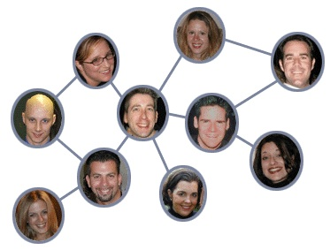
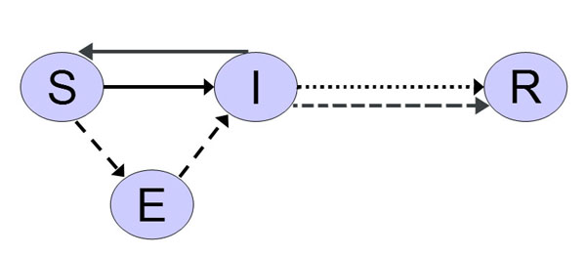
Key Terms
Social Network
SEIS Model
http://s3.amazonaws.com/readers/webupon/2008/04/09/140565_100.jpg

Slide 3
Previous Research Performed
Model disease spread within dynamic networks where associations shift according to preference lists based on three different measures of network centrality.
Network Centrality metrics by which preference lists are formed:
  Betweenness
  Closeness
  Degree (Popularity)

Slide 4
Previous Research Performed
We may also measure the “success” of the society modeled by our network by using “population-wide” versions of these network centrality measures:
  Degree (Popularity):
  Closeness:
  Betweenness:
Notes:
Population wide measures allow us to measure the overall P,C,B of individuals in a population as a whole.

Slide 5
Questions Addressed
Long- vs. Short-term friendships and the spread of disease
By keeping long term friendships and minimizing short-term contacts, are you less prone to getting a disease?
Varying the percentages of long- vs. short-term social contacts on patterns of disease spread in a population over time.
Varying the percentage of each duration of friendship among social contacts over time will affect disease dynamics.

Slide 6
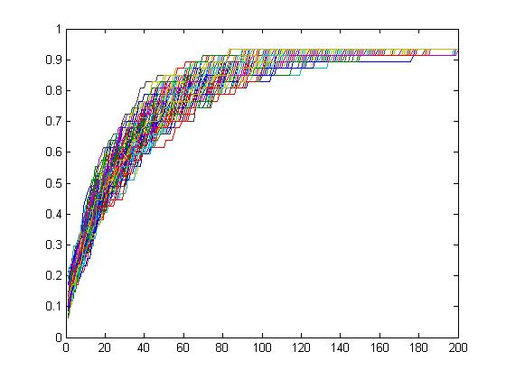
Assumptions
Computer | Test
Node | 50
Outdegree | 5
Neighbors Changed | 0.2, 0.4, 0.6, 0.8, 1.0
Time (Iterations) | 200
Introduction of Disease | 50
Transmission % | 0.8
Repetitions | 300
Mod Exchange | 1,5,10,25, 50

Slide 19
Questions Addressed
Duration of infectivity and disease in dynamic networks
What happens if we make the following adjustments to the dynamic workings of the network:
  If we include a fixed structure such as a “family”?
  If individuals make “smart” decisions concerning what friends they pick up?
  If individuals aren’t “social” once they become sick?

Slide 20
Popularity Success of a Society containing Families

Slide 21
Closeness Success of a Society containing Families

Slide 22
Betweenness Success of a Society containing Families

Slide 23
Popularity Success of a Society containing Families and in which the sick are “unsociable”

Slide 24
Closeness Success of a Society containing Families and in which the sick are “unsociable”

Slide 25
Betweenness Success of a Society containing Families and in which the sick are “unsociable”

Slide 26
Popularity Success of a Society containing Families and in which individuals choose friends “smartly”

Slide 27
Closeness Success of a Society containing Families and in which individuals choose friends “smartly”

Slide 28
Betweenness Success of a Society containing Families and in which individuals choose friends “smartly”

Slide 29
Popularity Success of a Society containing
Families, Unsociable Sick, & Smart Friend Choice

Slide 30
Closeness Success of a Society containing
Families, Unsociable Sick, & Smart Friend Choice

Slide 31
Betweenness Success of a Society containing
Families, Unsociable Sick, & Smart Friend Choice

Slide 32
Upcoming Goals
Determine causation for the various reactions in the success rates of the society given the different parameters.
Determine impact that these parameters have on the disease spread process, i.e. the variation in number of secondary infections, the rate of disease propagation, duration of the disease in the network, etc.

