Slide 1
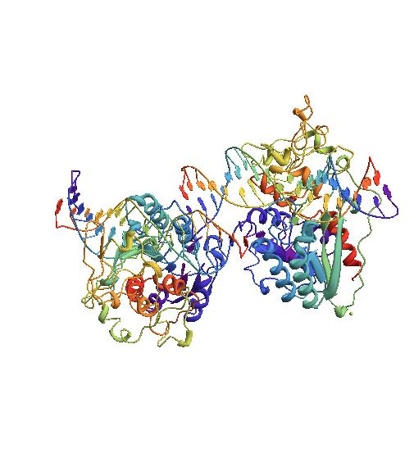
Protein-induced DNA Topology
Kathleen McClain
Hofstra University
Mentor: Wilma Olson
Methylase from HAEIII Covalently Bound to DNA
PDB ID: 1DCT
Notes:
Professor in the Chemistry Department and at BioMaPS (Biology at the Interface with the Mathematical and Physical Sciences) Institute for Quantitative Biology

Slide 2

DNA Basics
DNA contains the genetic information in most living organisms.
The sequence of bases within DNA contains instructions for the molecular content of every cell.
The human genome stretches out to be two meters long and fits inside cells which typically have diameters from 10 to 30 μm.
DNA usually exists as a right-handed double helix, but there are many other forms of DNA.
Generic B-form DNA
Notes:
For some viruses it’s RNA (HIV, retrovirus)
DNA stores information, is a blueprint for the body
Polymer, made of a chain, of nucleotides with an alternating sugar phosphate backbone
Instructions for proteins and RNA (as well as other stuff)
A, T, G, C – adenine, thymine, cytosine, guanine
Two strands are connected by hydrogen bonds between the bases
Micrometer = 10^-6
Circular DNA, some triple and quadruple helix DNA – A, B, Z type DNA (B most common) – left handed
Especially since the DNA needs to be very compact in order to fit inside cells.

Slide 3
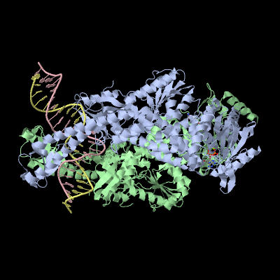
DNA-Protein Interactions
The way DNA functions within a cell is dependent on protein interactions.
  Either specific or non-specific protein interactions.
Proteins contribute to the way DNA is packaged inside cells.
Other proteins, such as polymerases, can alter the structure of DNA.
MutS-ADPBeF3-DNA Complex
PDB ID: 1NNE
Notes:
Specific protein interactions bind to a specific DNA sequence.
Enzymes catalyze chemical reactions.
Histones and nucleosomes. Chromatin and chromosomes.
RNA and DNA polymerase.

Slide 4
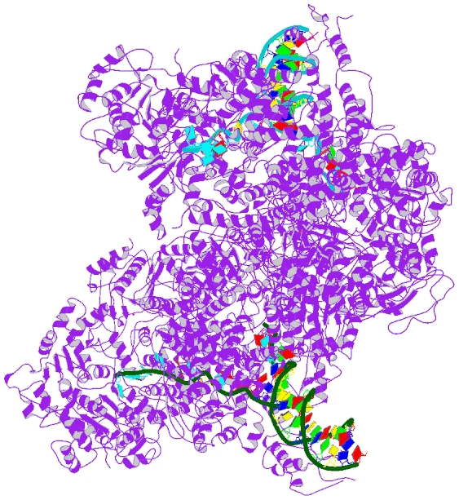
DNA “Melting”
DNA Binding to RecD
PDB ID: 1K70
All genetic information is
contained inside the DNA
double helix, so in order to
retrieve the information the
helix must be split.
When the double helix is opened, the hydrogen bonds between base pairs break and this leads to “melted” DNA.
This change always occurs before copying but can also occur when proteins are bound to the DNA molecule or when the molecule undergoes significant stress.
Notes:
Usually about 20 base pairs are separated (within transcription and replication)

Slide 5
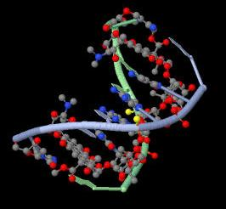
Why is DNA Topology Important?
The topology of a DNA molecule affects how it functions biologically.
  Many proteins and drugs affect the topology.
Changes in topology of a DNA molecule also make it possible to infer information about the way it reacts with specific proteins.
Antitumor Drug, Nogalamycin, Bound to DNA
PDB ID: 1D21
Notes:
Electrophoresis gels– if DNA reacts with a protein will sink faster in the gel.

Slide 6
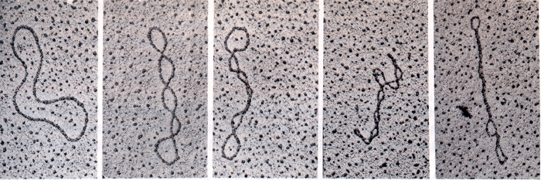
DNA Topology
Twist (Tw) is defined as the number of times one of the DNA strands is wound about the helical axis
Writhe (Wr) is how many times the helical axis crosses over itself and is a measure of overall folding.
Linking number (Lk = Tw + Wr ) is a topological invariant.
  Lk must be an integer, but Tw and Wr are not necessarily integers.
  A positive ΔLk means the molecule is overwound.
  A negative ΔLk means the molecule is underwound.
Image from the University of Arizona
Notes:
Overwound– more than the natural number of turns
Underwound– less than the natural number of turns (most underwound)
In the image, the most left DNA is relaxed and the level of supercoiling increases from right to left
Twisting and writhing contribute to the way that DNA is supercoiled.

Slide 7
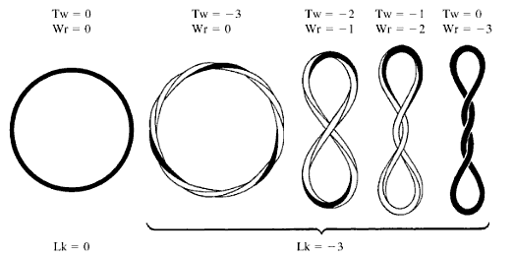
DNA Topology cont’d
Image from Understanding DNA: the molecule and how it works (3rd edition)
Notes:
Clockwise twist = overwound + (like a corkscrew)
Counterclockwise twist = underwound –
Right handed writhe = +
Left handed writhe = -

Slide 8
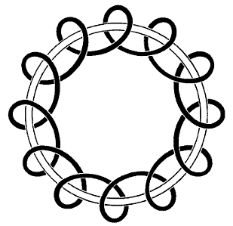
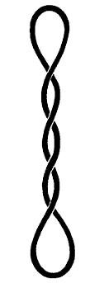
DNA Topology cont’d
Toroidal Structure
Interwound Structure
Images from Understanding DNA: the molecule and how it works (3rd edition)
Notes:
Toroidal structure coils around an imaginary toroid or ring.
Real DNA supercoils can have portions of both toroidal and interwound geometries, which can occur together.

Slide 9
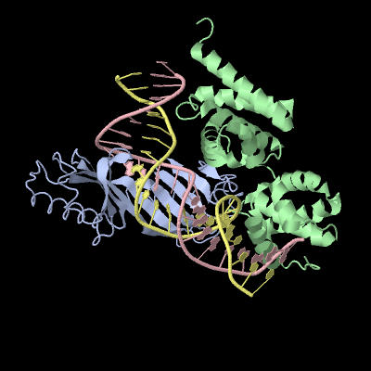
DNA Topology cont’d
TATA-Binding Protein and Transcription Factor Bound to DNA
PDB ID: 1D3U
Tw(D,C) =
Wr(C) =
Lk(D,C) =
Notes:
Although sometimes it is relatively easy to figure out the Tw, Wr, and Lk of some structures, for many others it is nearly impossible just by looking
So before mathematicians became interested in DNA, it was not possible.
D and C are curves.
C helical axis, and D is one of the strands
Double integral = Gauss integral
t(_) is the tangent, s is an arc, r(_) is a point, omega is also a vector.

Slide 10
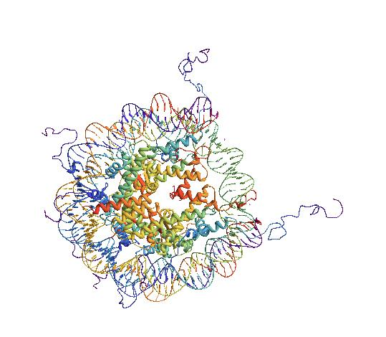
MY RESEARCH:
The equation for twist as shown previously do not work for “melted” DNA.
So we need to develop a universal way to calculate these values for “melted” DNA.
Our data are coming from the Nucleic Acid Database and the RCSB Protein Data Bank.
We will be using Mathematica and w3DNA to reconstruct and analyze the topology of DNA-protein complexes.
Nucleosome Core Particle
PDB ID: 1KX5
Notes:
For melted DNA, we don’t know where the helical axis lies (major problem).
NDB funded by NSF and Department of Energy – Dr. Olson is a co-founder.
RCSB = Research Collaborative for Structural Bioinformatics
w3DNA (Dr. Olson is also a co-founder) – web-based program used to reconstruct, analyze, and visualize structures containing nucleic acids.

Slide 11
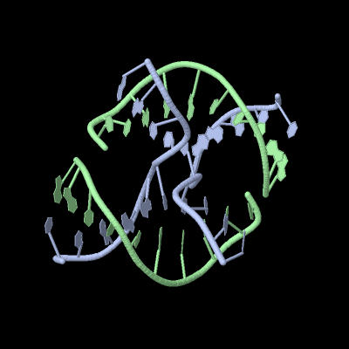
Acknowledgements
Wilma Olson
Andrew Colasanti
Nicolas Clauvelin
Holliday Junction
PDB ID: 1ZF2

