Slide 1
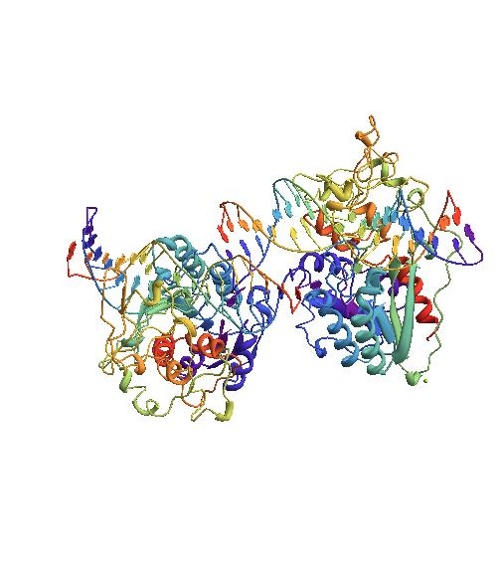
Protein-induced DNA Topology
Kathleen McClain
Hofstra University
Mentors: Wilma Olson
Nicolas Clauvelin
Methylase from HAEIII Covalently Bound to DNA
PDB ID: 1DCT
Notes:
Olson-- professor in the Chemistry department and BioMaPs Institute
Clauvelin-- post-doc at BioMaps Institute

Slide 2

Introduction
DNA contains the genetic information in most living organisms.
DNA is made up of an alternating sugar-phosphate backbone and the two strands of the double helix are attached through hydrogen bonds between the base pairs.
The sequence of bases within DNA contains instructions for the molecular content of every cell.
Protein-DNA interactions are important because DNA functions are dependent on those proteins.
Generic B-form DNA
Notes:
DNA is mostly used as information storage, but similar to a blueprint.
DNA is a chain of nucleotides.
Instructions for proteins and RNA, as well as other stuff
Adenine, guanine, thymine, and cytosine
A, B, Z DNA
Right and left handed.
Some circular or have three or four strands of DNA
Protein help package the DNA since two meters of information need to fit inside a cell that typically has a diamteer of 10 to 30 micrometers (10^-6)

Slide 3
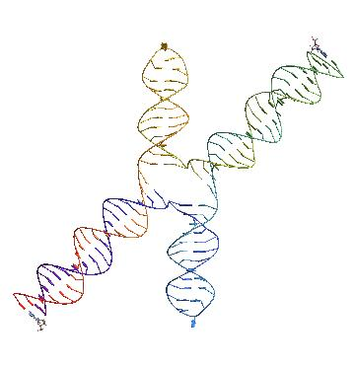
Melted DNA
Genetic information is contained inside the DNA double helix, in order to access it the DNA must be split.
Four Way Junction
The splitting breaks hydrogen bonds between base pairs and leads to a melted DNA structure.
  This always occurs before copying but can also occur when a protein binds to the molecule or if the molecule undergoes significant stress.
Notes:
In transcription and replication usually around 20 base pairs separate.

Slide 4
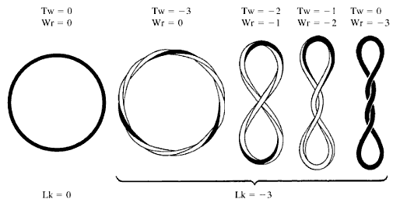
DNA Topology
The topology of a DNA molecule affects how it functions biologically.
Twist (Tw), Writhe (Wr), and Linking Number (Lk) are three values that help to define the topology of DNA.
  But only one of those, Linking number, can be calculated for melted DNA.
Image from Understanding DNA: the molecule and how it works (3rd edition)
Notes:
Proteins and drugs act on the topology to force the DNA to function a specific way.

Slide 5
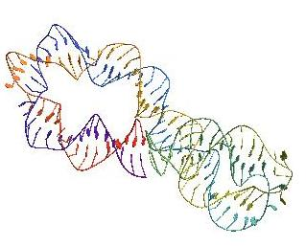
My Research
The existing equation for twist does not work for melted DNA because the helical axis cannot easily be defined.
So we were looking to develop a systematic way to calculate these values for melted DNA.
Our data came from the Nucleic Acid Database, the RCSB Protein Data Bank and Jonathan Mitchell from the University of Leeds, UK.
We used Mathematica to reconstruct and analyze the topology of DNA-protein complexes.
  We gathered distances between specific atoms, areas of polygons with the atoms as vertices, and angles with the atoms as vertices.
Courtesy of Jonathan Mitchell (University of Leeds, UK)
Notes:
Not knowing where the helical axis lies is a major problem because that information is needed to use the equation that exists.

Slide 6
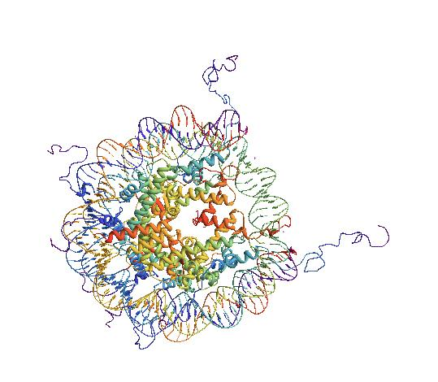
My Research
Once being introduced to Mathematica and its PDB format capabilities, I began to build my own program for extracting the information needed.
After getting the values wanted, the data were put into histograms and line plots with the means and standard deviations.
Then the data were compared with what was already known about the structures (i.e. bubbles, flipped out bases, and other unique characteristics).
Nucleosome Core Particle
PDB ID: 1KX5

Slide 7
My Research
Pj+2
Pj+1
Pj
Pj-1
Nj+1
Nj
Nj-1
Nj-2
Ni-2
Ni-1
Ni
Ni+1
Pi-1
Pi
Pi+1
Pi+2
Notes:
Since DNA is always read 3’ to 5’ end, the subscripts of each strand run in opposite directions
The typical diameter of DNA is 20 angstroms.
A & G -> N9
T & C -> N1

Slide 8
My Research
Pj+2
Pj+1
Pj
Pj-1
Nj+1
Nj
Nj-1
Nj-2
Ni-2
Ni-1
Ni
Ni+1
Pi-1
Pi
Pi+1
Pi+2
Notes:
P-P N-N P-N P1-N
Angle Areax3 P-P Across N-N Across

Slide 9
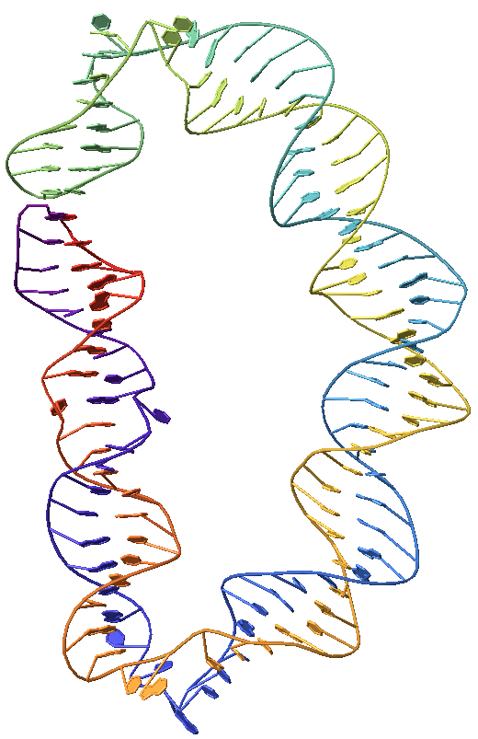
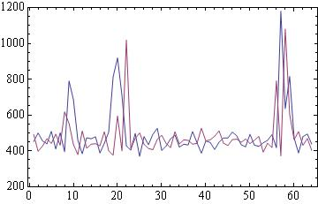

Research Results
We found that bubbles can cause major fluctuations at specific data points.
  Example: The locations of the three bubbles of the melted DNA with linking number 5.
Bubble Lk 5
Ni-Ni+1 Distances
Distance (pm)
Courtesy of Jonathan Mitchell (University of Leeds, UK)
Base pair number

Slide 10
Research Results
But the means of the data of all our structures, both melted and not, are relatively conserved.
 | B DNA | Nucleosome | Bubble Lk5 | Bubble Lk6 | Bubble Lk7
Pi-Pi+1 (pm) | 663 | 668 | 671 | 677 | 677
Ni-Ni+1 (pm) | 438 | 446 | 489 | 465 | 481
Pi-Ni (pm) | 524 | 545 | 569 | 573 | 559
Pi+1-Ni (pm) | 564 | 555 | 567 | 568 | 568
Ni-Pi-Pi+1 Angle (°) | 55 | 53 | 53 | 53 | 53
Pi-Ni-Pi+1 Area (pm²) | 143000 | 145000 | 152000 | 154000 | 151000
Ni-Pi+1-Ni+1 Area (pm²) | 109000 | 111000 | 119000 | 119000 | 119000
Quadrilateral Area (pm²) | 251000 | 256000 | 271000 | 274000 | 269000
P Across Strands (pm) | 1880 | 1790 | 1870 | 2000 | 1950
N Across Strands (pm) | 895 | 857 | 934 | 906 | 921
Notes:
GOOD!

Slide 11
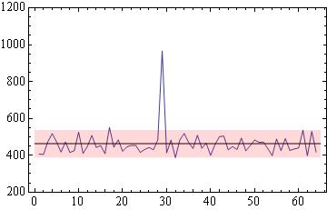
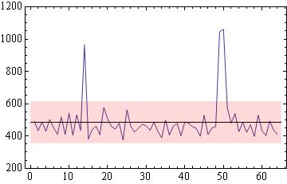
Research Results
We also found that when bubbles cause a peak in the data, the value of the peak was very similar for the same measurement in each of the three bubble structures.
  An example of this is the
  Ni-Ni+1 distance data, each peak is about 1000 pm.
Bubble Lk6
Ni-Ni+1 Distances
Bubble Lk7
Ni-Ni+1 Distances
Distance (pm)
Distance (pm)
Base pair number
Base pair number

Slide 12
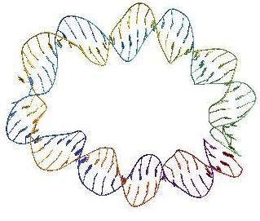
What’s Next
The ultimate goal is to construct a formula to calculate the twist of melted DNA structures.
The next step would be to see how the data already collected could help lead us in the right direction.
We also would need to consider what other measurements and information from the DNA molecules is needed to formulate an equation.
Courtesy of Jonathan Mitchell (University of Leeds, UK)

Slide 13
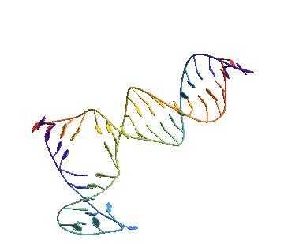
Acknowledgements
Wilma Olson
Nicolas Clauvelin
Andrew Colasanti
PDB ID: 1JEY

