Slide 1
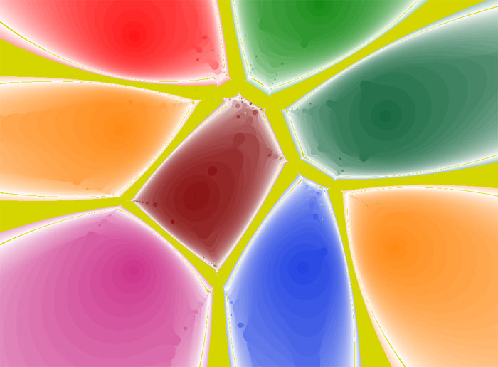
Polynomiography
with Dr. Bahman Kalantari

Slide 2
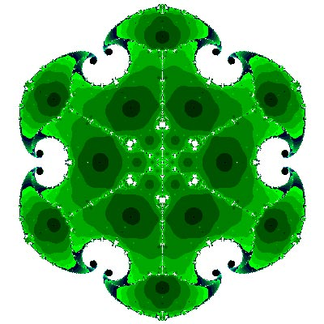
What is polynomiography?
Dr. Kalantari informally defines polynomiography as a certain graph of polynomials
He formally defines it as the art and science of visualization in approximation of the zeros of complex polynomials, via fractal and non-fractal images created using the mathematical convergence properties of iteration functions

Slide 3
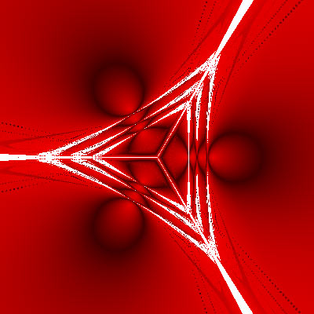
SLOW DOWN!
First of all, what’s an iteration function?
Newton’s Method is an example:
N(z) = z − p(z)/p’(z)
Iteration functions are used to determine which points will eventually map to the roots of the function being analyzed, essentially the objective of polynomiography
Notes:
-An iteration function is a mapping of the plane
into itself, i.e. given any point in the plane, it is a rule that provides another point in the plane.

Slide 4

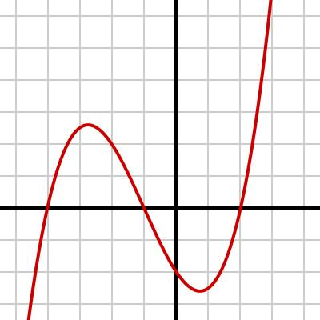
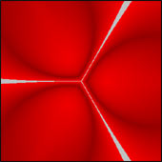
The Result, the Objective
By producing a graph of these regions of convergence, or polynomiograph, we can represent functions is a new way:
              VS

Slide 5
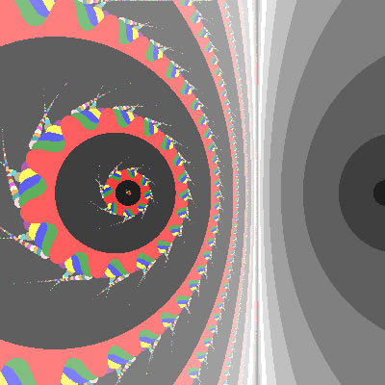

The Case of z³-1

