Slide 1
Applying Line Graphs to Resource Allocation During Extreme Events
Leonard Lopez
Sergio Sandoval

Slide 2
Applying Line Graphs to Resource Allocation During Extreme Events
Leonard Lopez
Sergio Sandoval

Slide 3
Using Graph Theory to Reallocate Firefighter Resources
Leonard Lopez
Sergio Sandoval

Slide 4
Introduction to the Firefighter Problem
Graph theory problem introduced by Bert Hartnell
Objective is to find strategy that contains an undesirable spread
Examples:
  Fire spreading and firefighters
  Modeling flood and sandbaggers
  Virus spread and vaccine dispersal
Notes:
How presentation will benefit audience: Adult learners are more interested in a subject if they know how or why it is important to them.
Presenter’s level of expertise in the subject: Briefly state your credentials in this area, or explain why participants should listen to you.

Slide 5
Firefighter Problem Description
Fire breaks out at a finite number of vertices at time t = 0
Firefighters are placed on some empty (non-burning) vertices at t = 1
Fire spreads from vertices on fire to undefended adjacent vertices
Additional firefighters are placed on empty (non-burning and undefended) vertices at time t = 2
Vertices that are defend remain defended
The process repeats
Objective is to contain the spread of the fire by repeating this process until the fire can no longer spread
Notes:
Lesson descriptions should be brief.

Slide 22
Previous Work
Wang and Moeller (2002) showed that given any single fire outbreak in an infinite two dimensional grid, two firefighters every time step is sufficient enough to contain the fire.
Hartke (2004) verified Wang and Moeller’s results and proved that the minimum number of vertices that will be burned is 18 and the minimum number of steps required to contain the fire is 8.
Raff and Ng (2008) proved that if the number of firefighters available is periodic in t and the average exceed 1.5, then a finite number of fire outbreaks can be contained.
Notes:
Example objectives
At the end of this lesson, you will be able to:
Save files to the team Web server.
Move files to different locations on the team Web server.
Share files on the team Web server.

Slide 23
Firefighter Problem: Our Approach
Consider two dimensional directed infinite graph defined by
Goal: Determine a strategy to optimally place f(t) firefighters at time interval t to best contain the fire

Slide 24
Definitions
represents the number of new firefighters in round
At round , you have vertices on fire.
is the number of susceptible vertices

Slide 25
Source and Sink Nodes
Source node: A vertex with 0 in-degree
  Labeled as orange
Sink node: A vertex with 0 out-degree
  Labeled as light blue

Slide 26
Strategy
Begin with one non-sink start vertex on fire
Identify all source and sink nodes
Force fires into sink nodes
  Make use of source nodes
  Shortest path algorithm
  Greedy algorithm that minimizes the amount of susceptible vertices
Test algorithm using Maple

Slide 27
Continuing the Project
Complete and expand the algorithm
  Consider finite number of vertices that initially catch on fire
  Consider weighted graph, where weights are the probability that an unprotected node would catch fire given that a neighbor is on fire
Combine algorithm with existing data to develop an applicable model
  Greater San Diego Area

Slide 28
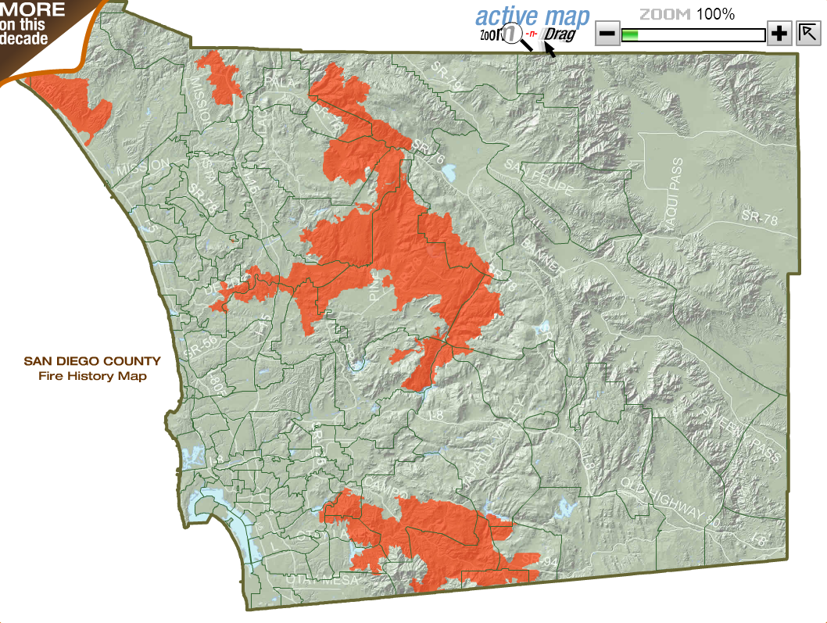
Historical Data: San Diego, 2007
Coronado Hills
Ammo
Harris
Rice
Witch
Poomacha

Slide 29
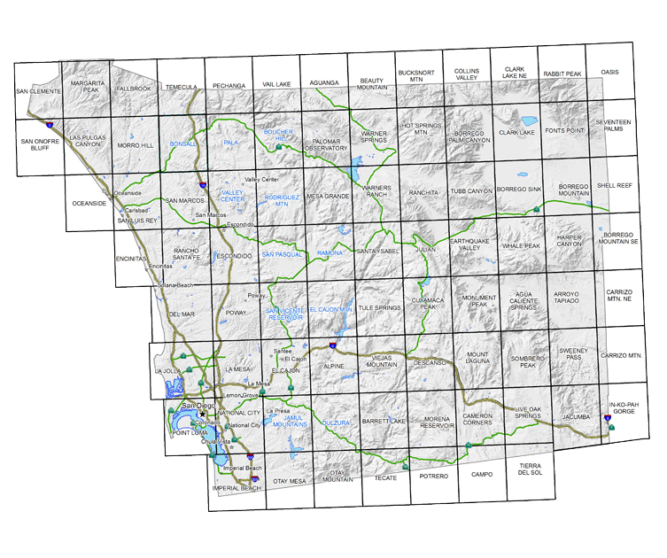
San Diego
Camp Pendleton
Riverside March
Ramona
Thermal
Imperial Beach
Palm Springs
Carlsbad
Oceanside
Miramar
Santee
Campo
Montgomery
Brown
North Island

Slide 30
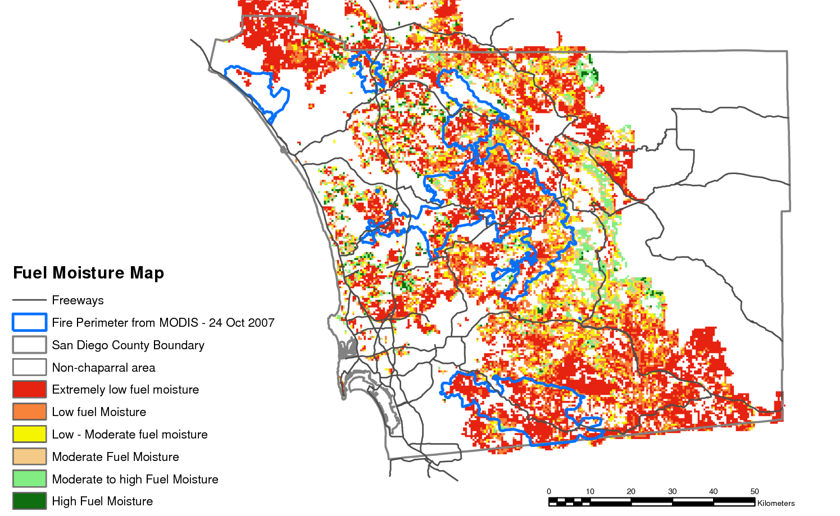
Factor: Fuel
The total amount of available flammable material

Slide 31
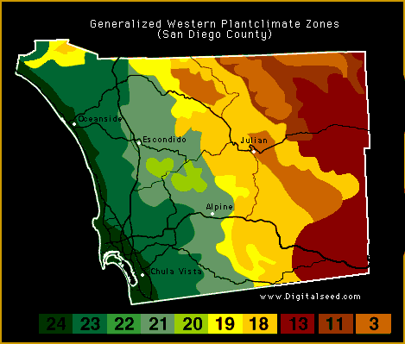
Factor:
Temperature
Air temperature has a direct influence on fire behavior because of the heat requirements for ignition and continuing the combustion process.

Slide 32
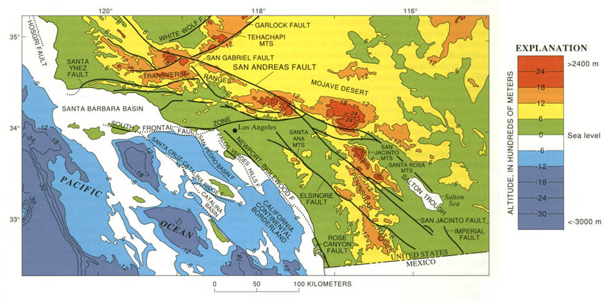
Factor: Altitude
At higher altitude: the flame height and
flame spread rate decreases, but the flame temperature
increases.

Slide 33
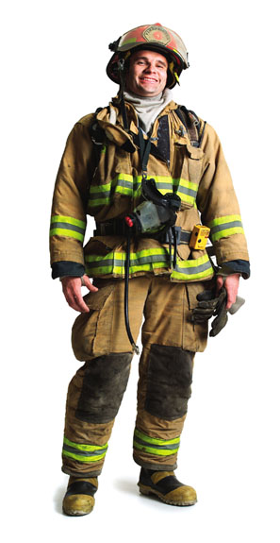
Factor: Wind
Wind has a strong effect on fire behavior due to the fanning effect on the fire.

Slide 34

Wind
Supplies oxygen
Reduces fuel moisture
Move the fire

Slide 35
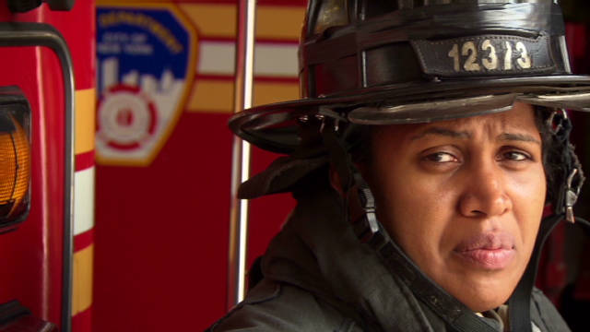
And…
Thanks for showing us the algorithm.
the fire is contained!
Special thanks to Gene Fiorini.

Slide 36

And…
the fire is contained!
Special thanks to Gene Fiorini.

Slide 37
References
[Ng and Raff 2008] K. L. Ng and P. Raff, “A generalization of the ﬁreﬁghter problem on ZxZ”,Discrete Appl. Math. 156:5 (2008), 730–745.
[Wang and Moeller 2002] P. Wang and S. A. Moeller, “Fire control on graphs”, J. Combin. Math. Combin. Comput. 41 (2002), 19–34
[Hartke 2004] S. G. Hartke, Graph-Theoretic Models of Spread and Competition, Ph.D. thesis,Rutgers, 2004, http://dmac.rutgers.edu/Workshops/WGDataMining/HartkeDissertation.pdf
[Finbow and MacGillivray 2009] S. Finbow and G. MacGillivray, “The ﬁreﬁghter problem: a survey of results, directions and questions”, Australas. J. Combin. 43 (2009), 57–77
[Fogarty 2003] P. Fogarty, “Catching the ﬁre on grids”, Master’s thesis, Department of Mathematics, University of Vermont, 2003, http://www.cems.uvm.edu/~jdinitz/ﬁreﬁghting/ﬁre.pdf.
[Hartnell 1995] B. Hartnell, “Fireﬁghter! An application of domination”, conference paper, 25th Manitoba Conference on Combinatorial Mathematics and Computing, 1995

