Slide 1


Sharp Transitions of Collision Behavior in Multi-Robot Systems
Angelo Carrabba
Notes:
This summer I will be working on Path planning for collision avoidance in a multi-agent system.

Slide 2

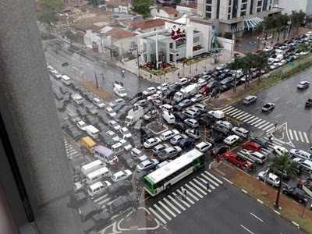
Navigation of Agents in an Environment
Path planning for robots in a somewhat unstructured environment
How the properties of the system affect the number of collisions or the level of traffic
Notes:
Picture 1: Kiva Systems (used by amazon)
Picture 2: Sharp transition
How sharp transitions affect the situation

Slide 3
Project Description
The observation of collision behavior
Identify sharp transitions in the system
Determine how the properties of the system affect probability of collision
Method of planning to avoid collisions
Notes:
I will be studying the setting of a room filled with robots in which they have a starting point and a destination.
Looking at the properties of the system, in order to take advantage of those properties.
Specifically trying to determine if there is a point of sharp transition.

Slide 4
Goals
Run simulations to Determine
  The properties of the system
  How the percentage of collisions increases as the properties change
  If there are any sharp transitions
Form and test hypotheses on how to plan the paths of the agents based upon properties of the system
Notes:
See if there is a sharp change in the percentage of collisions for a multi-agent environment based upon the underlying parameter changes, then work on a solution for navigating the robots efficiently to their goals.
Sharp changes
However, it is well known that determining the most efficient route is actually an intractable problem for larger parameters, meaning that although the solution could be found it would take way too long for it to be determined in a reasonable amount of time.
So finding a good estimation would work.

