Slide 1
Sharp Transitions of Collision Behavior in Multi-Robot Systems
Angelo Carrabba

Slide 2



Multi-Robot Systems
Notes:
- More popular, study behavior of in order to take advantage, and also avoid problems with

Slide 3
Sharp Transitions
A sharp change from one phase to another
Sparsely populated space to Populated space with large amount of interaction

Slide 4
Sharp Transitions (Random Geometric Graph)

Slide 5
System Interaction
How much robots interact
Modeled by discs in simulation
Monitoring collisions only

Slide 6
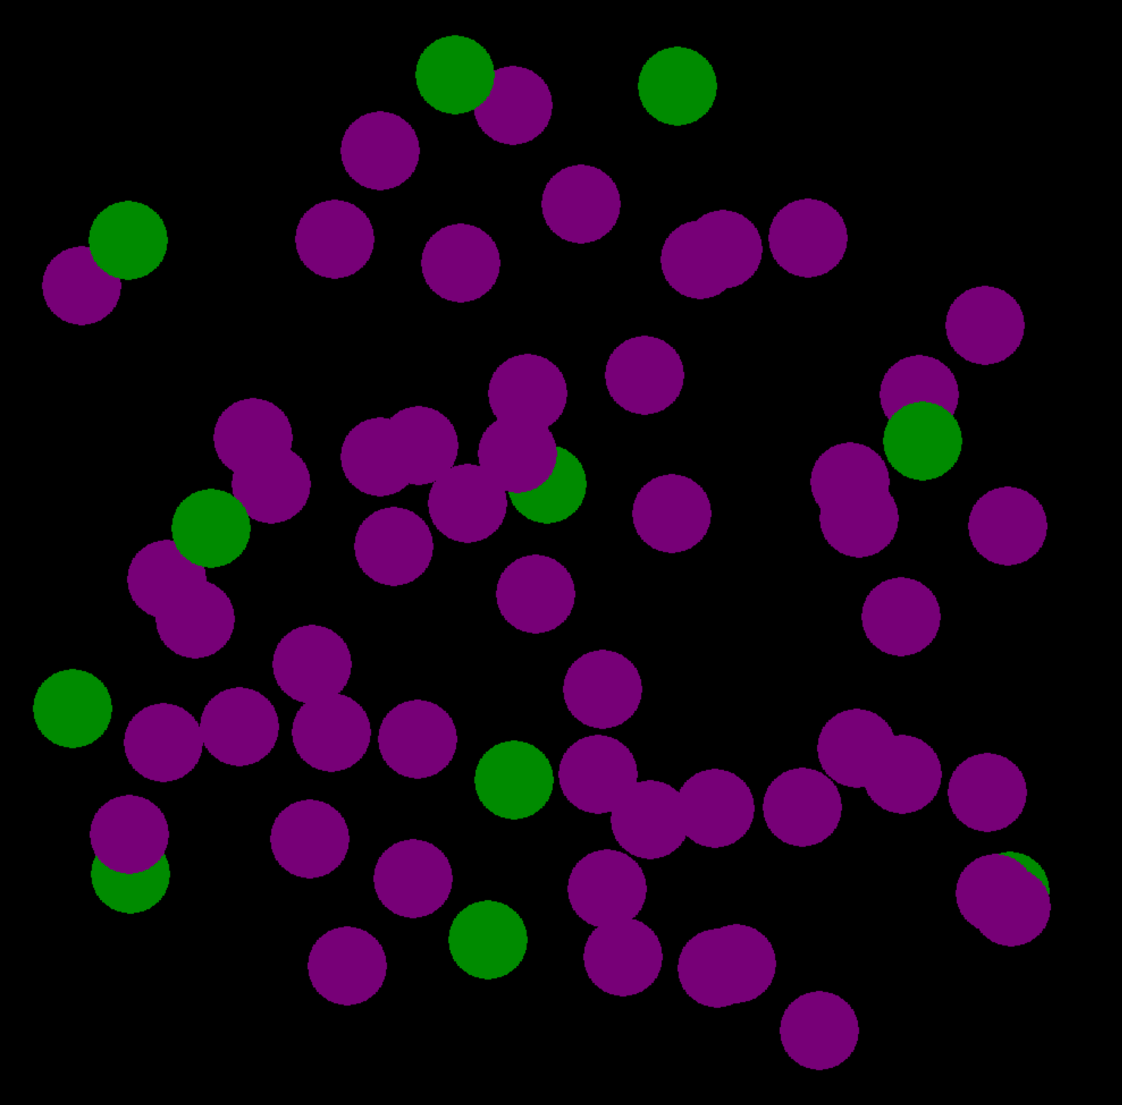
Continuous Setting
Notes:
Random Geometric Graph, Random Graph connectivity – Sharp Transition

Slide 7
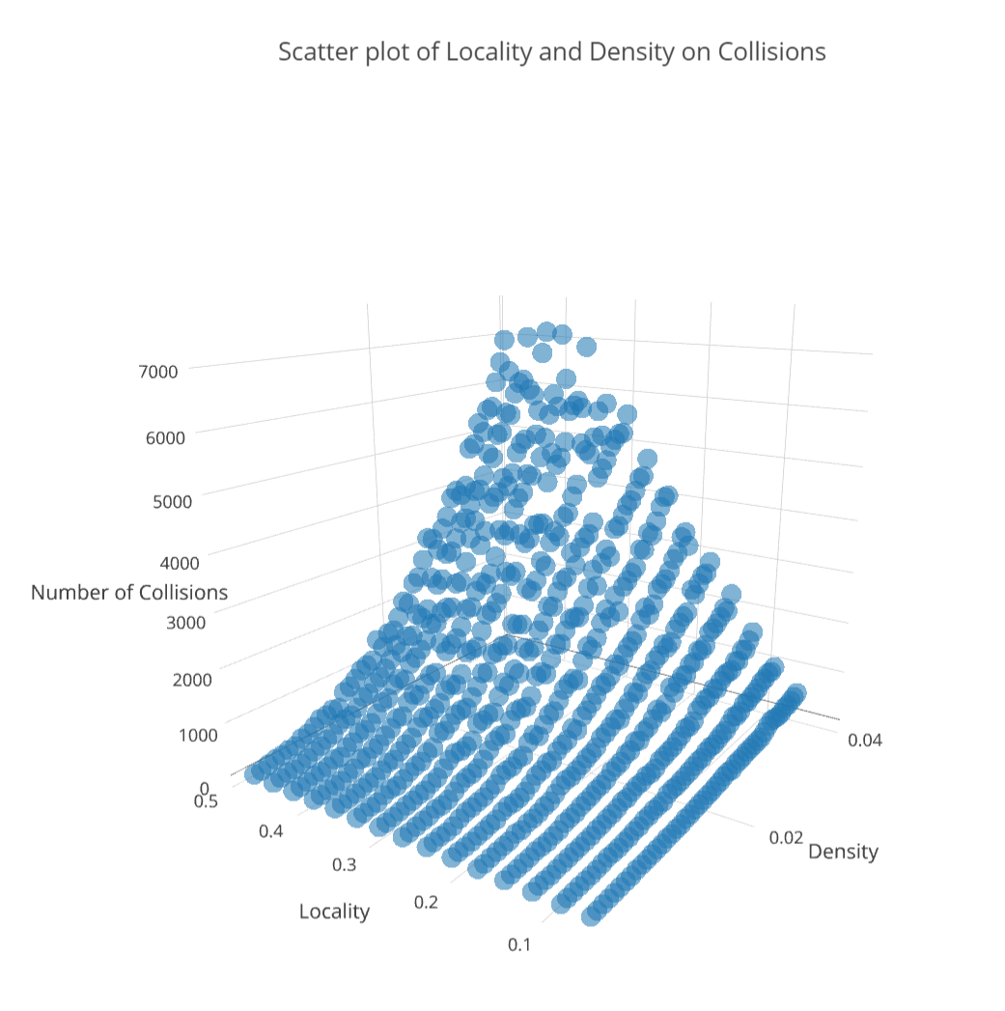
Results for Continuous Setting
(Disc Radius: .05)

Slide 8
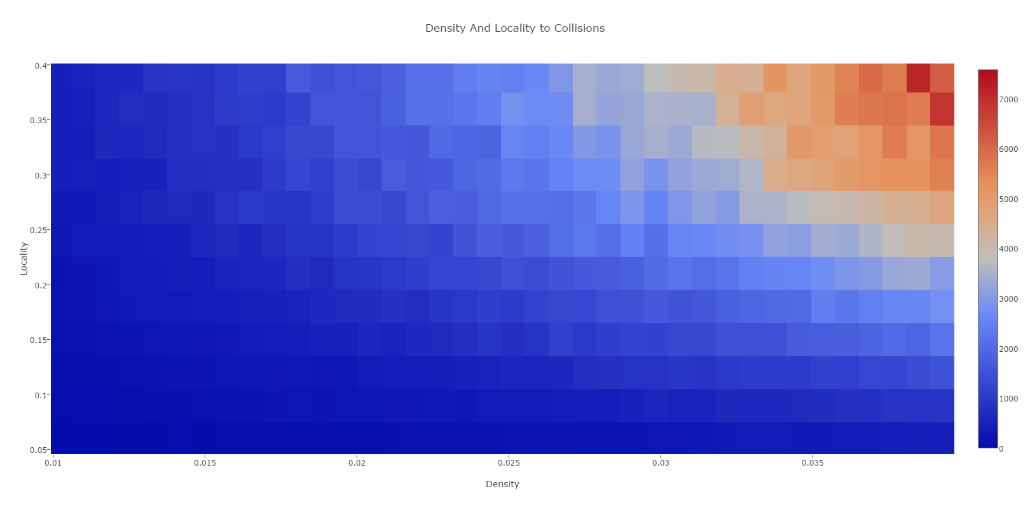
Results for Continuous Setting
(Disc Radius: .05)

Slide 9
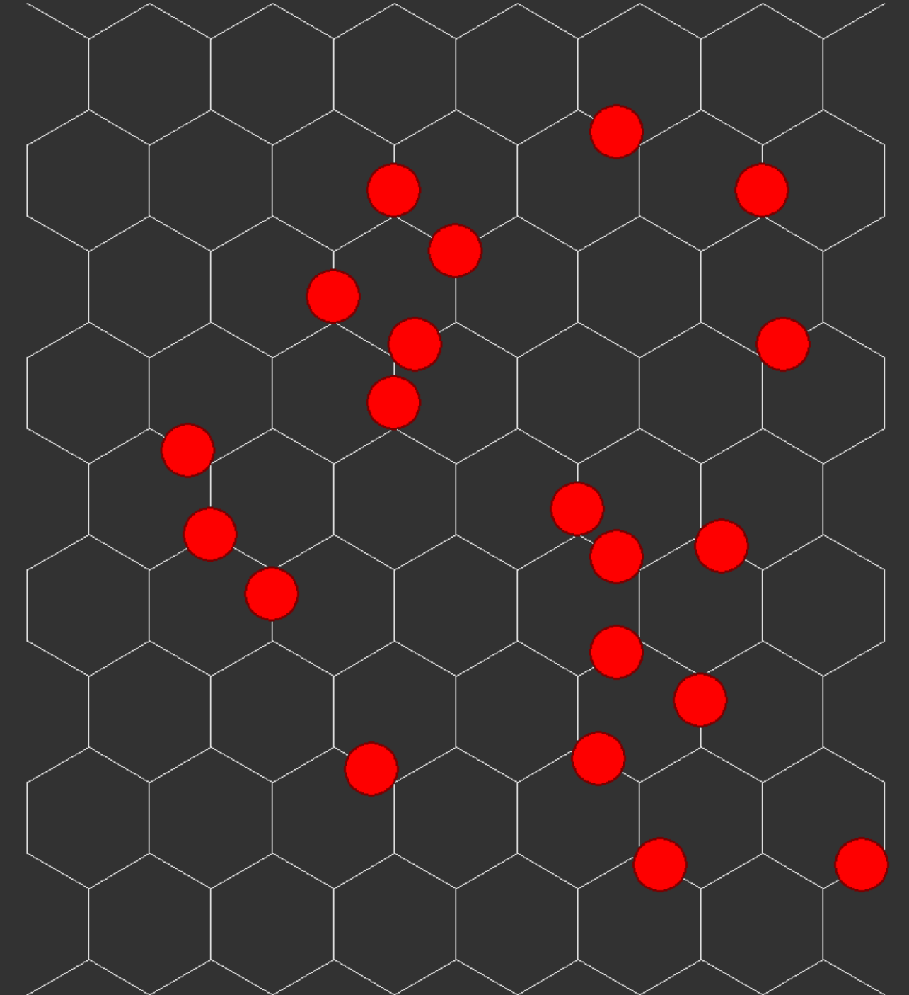
Discrete Setting

Slide 10
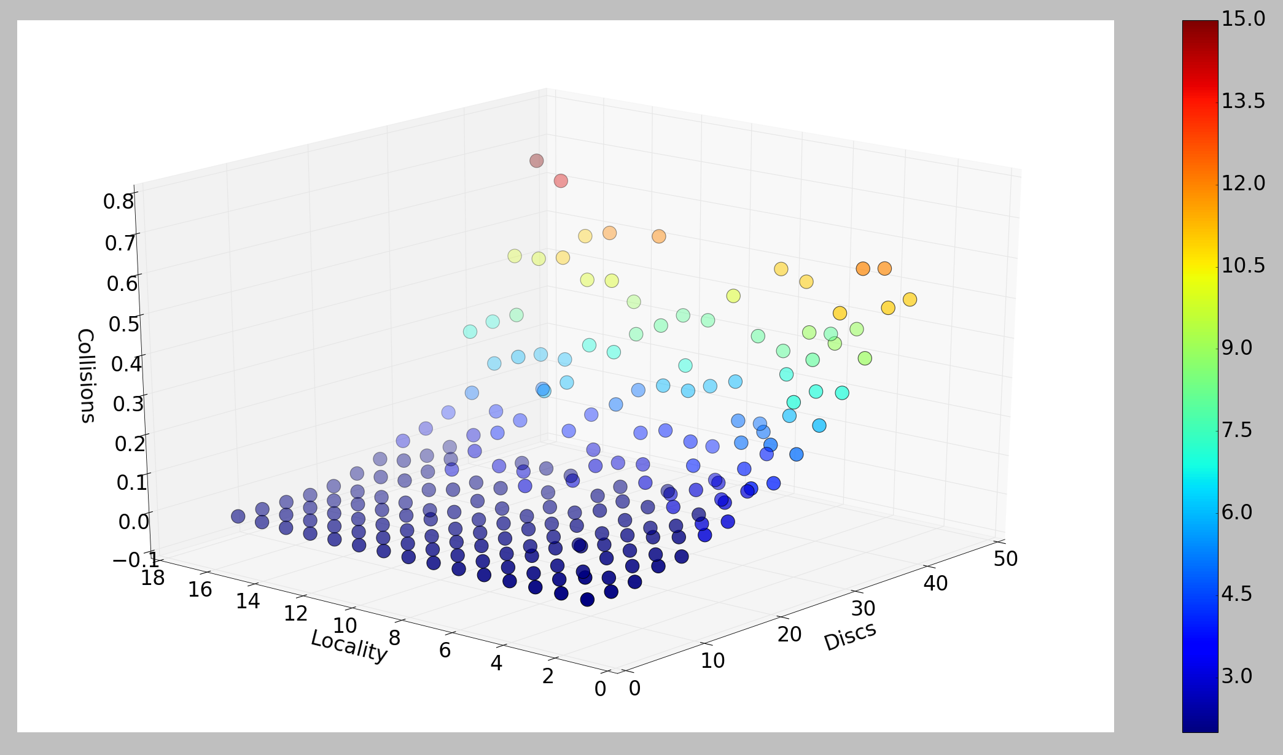
Results for Discrete Setting
(Samples per point: 200, Nodes: 360)

Slide 11
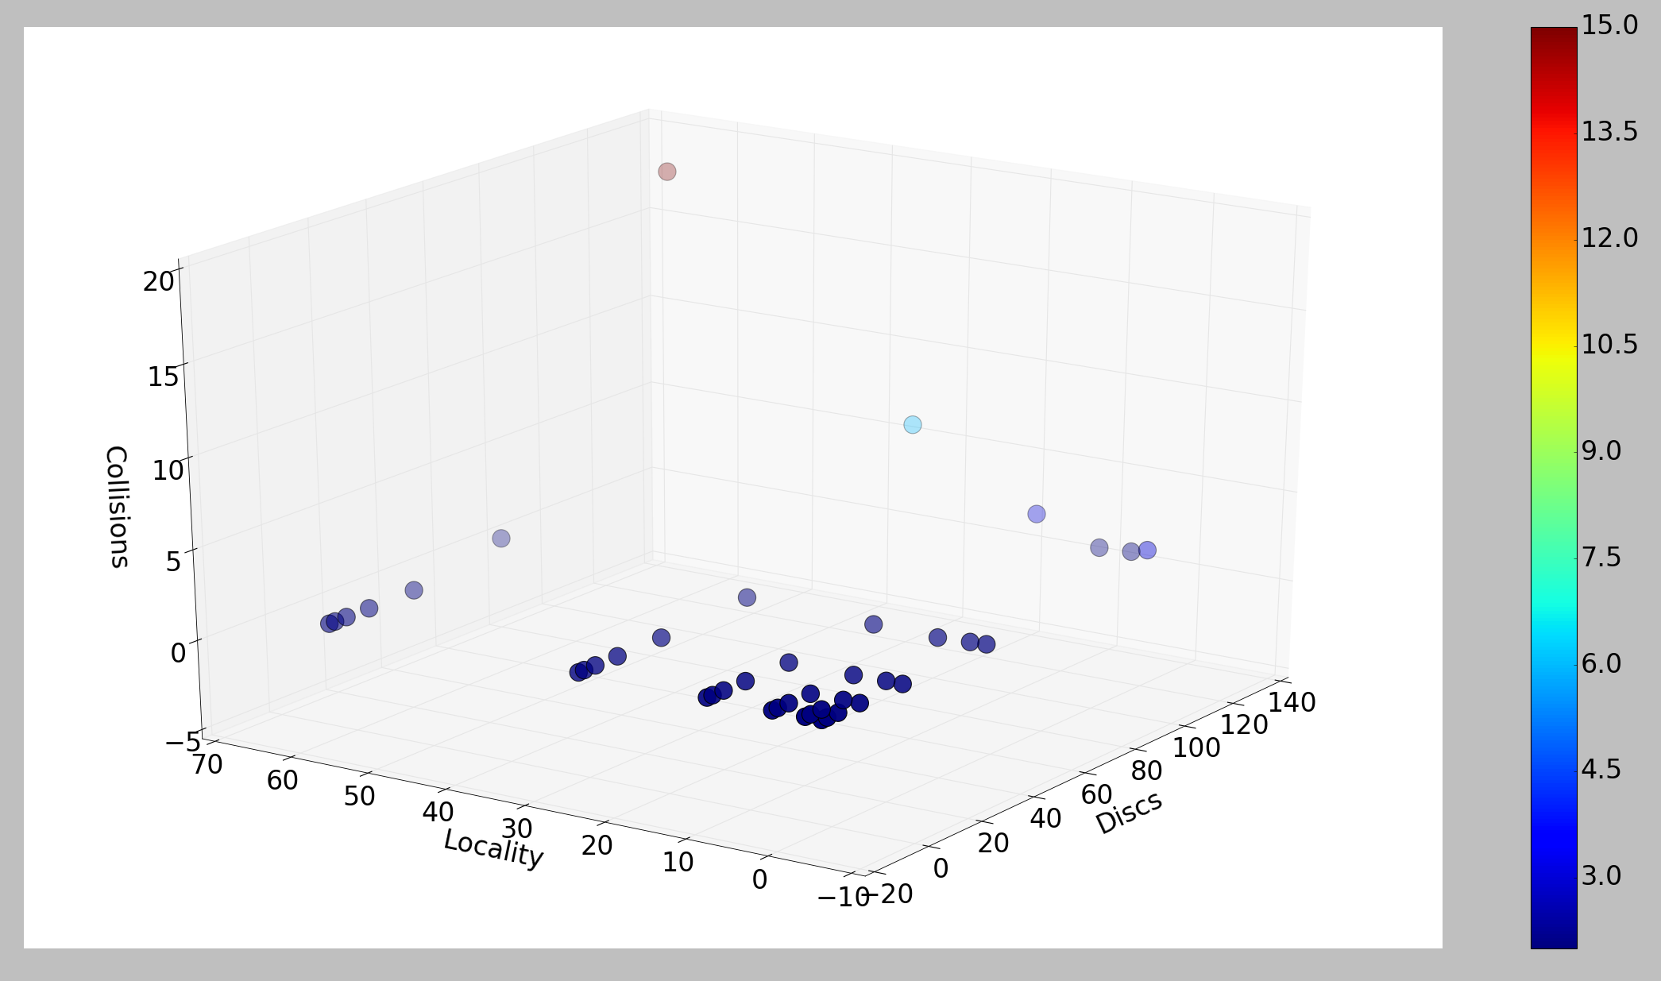
Results for Discrete Setting
(200 samples per point, 1000 nodes)

Slide 12
Future Research
Implement more advanced avoidance behavior
Study the system under different constraints
Find which attributes would create a sharp transition

