Slide 1
Optimal Train Scheduling
Researcher: Kajal Chokshi
Mentor: Dr. Grace Guo
DIMACS REU Summer 2016
Funded by NSF, Data by Union Pacific

Slide 2
Overview
Scheduling trains on single tracks depending on various constraints
Model created in past for two main objectives
Decision Support tool
Planning tool
Notes:
Various constraints include types of cargo, time of travel, etc.
Try to minimize cost and delay!
Decision Support Tool for train dispatchers to schedule trains in real time
Planning Tool to evaluate impact of timetable changes

Slide 3
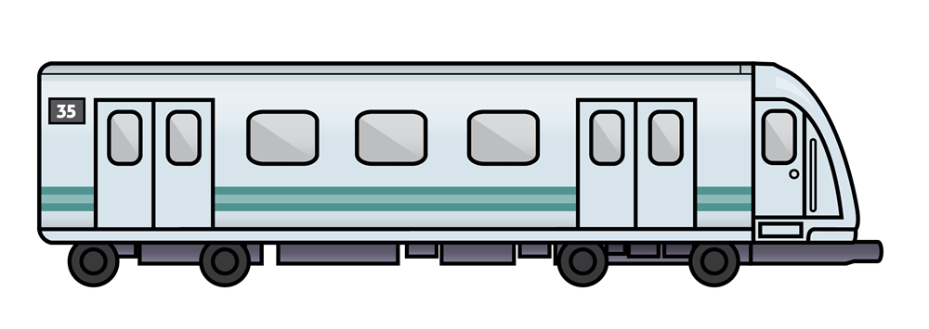
Definitions
Train Conflict-
Crossing: Two trains approach each other on a single line track and the continuation of either or both train’s journey wouldn’t be possible
Overtake: A faster train catches up to a slower train travelling in the same direction

Slide 4
More Definitions (Given by A. Higgins)
Siding- A section of a track which can be used for the crossing and passing of trains under single track operations
Conflict Delay- Delay to a train if it must wait at a siding for another train to cross or takeover
Risk of Delay-The expected amount of delay due to unforeseen events
Total Delay- Weighted combination of conflict delay and risk of delay
Ex. Two trains unable to stop at the same siding, causing conflict delay

Slide 5
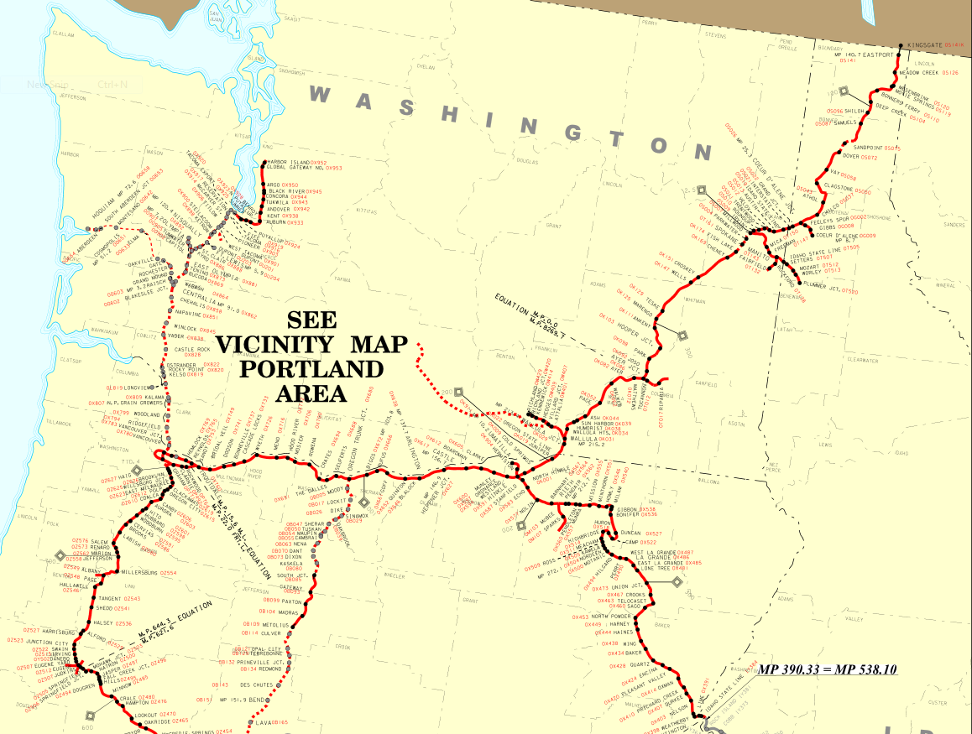
Given Information
Dataset from a company regarding single track train schedules
Background information regarding optimization

Slide 6
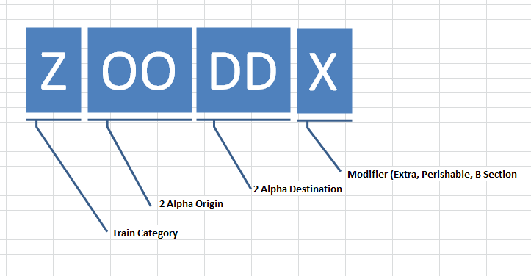
Dataset
Ex.
Train Symbol: ACYBAX
Train Category: Auto
Alpha Origin: Cheyenne
Alpha Destination: Barnes
Modifier: Extra

Slide 7
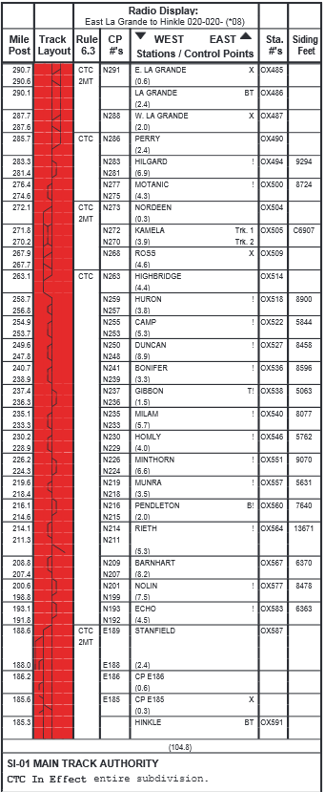
Dataset Continued
Ex. Continued
Traveling West from La Grande → Huntington → Nampa
From the Excel Dataset, we see this train stopped 9 times in segment- Why is that?
Possible ways to make route more efficient by considering other constraints?
How can we predict the behavior of the train without having a dataset provided by the company?

Slide 8
Goals
Visualize the data using SAS programming
Generate data for simulation by building a probability distribution
Minimize delay and cost
Notes:
Visualize using SAS programming such as bar charts of trains on different days, times, types of trains
Generate data for simulation to create different scenarios
Minimize delay and cost using the branch and bound procedure

Slide 9
References
    A. Higgins
    Optimal Scheduling of Trains On a Single Line Track
    Ph.D. Thesis, Faculty of Science, Queensland University of Technology (1996)
    A. Higgins
    Modelling the Number and Location of Sidings on a Single Line Railway
    Ph.D. Thesis, Faculty of Science, Queensland University of Technology (1997)
    Union Pacific Trainline Dataset

