Slide 1
Genomic Data-Guided Mathematical Modeling of Cancer
DIMACS REU Final Presentation
Andrew Brettin
University of Minnesota
Mentor: Dr. Subhajyoti De
Cancer Institute of New Jersey

Slide 2
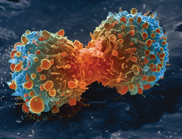
Introduction
Cancer is a classification of diseases characterized by abnormal and unregulated cell growth
About 40% of Americans will develop cancer within their lifetimes (American Cancer Society 2018)
Worldwide, 1 in 6 deaths is due to cancer (World Health Organization 2018)

Slide 3
Motivation
Cancer begins from a single cell
As the tumor grows, cells may acquire mutations upon cell division, which confer selective advantages and proliferate throughout the cell
By the time of diagnosis, tumors typically have on the order of 10⁹ cells
High intratumor heterogeneity is associated with poor survival rates.
How intratumor heterogeneity develops is not well understood.

Slide 4
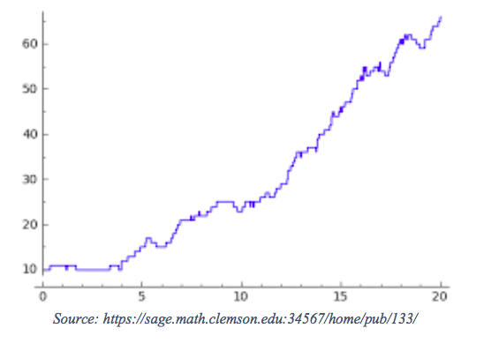
Mathematical modeling
Reaction-diffusion equations:
  Reaction term:
Stochastic modeling & operator splitting method (Choi 2012):
  Diffusion is modeled using Brownian motion
  Reactions are simulated using the Gillespie Stochastic Simulation Algorithm (Erban et al 2007)

Slide 5
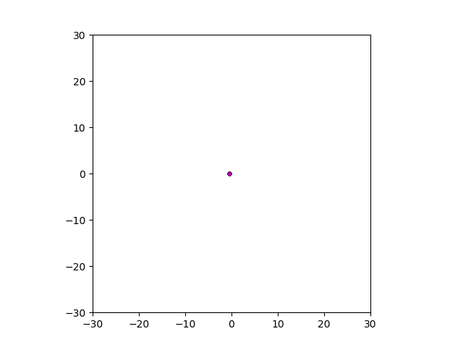
Results: Control

Slide 6
Results
Control
Driver mutations increase natural birth rate

Slide 7
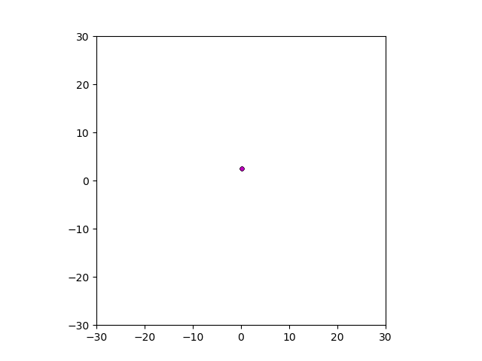
Results
Control
Higher diffusion rates

Slide 8
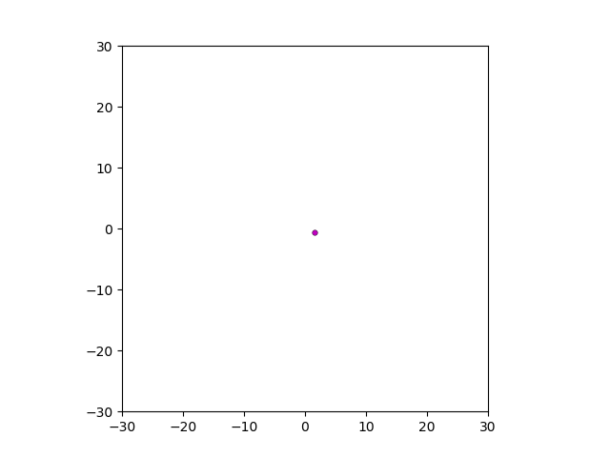
Results
Control
Mutation occurs in early stages of tumor growth

Slide 9
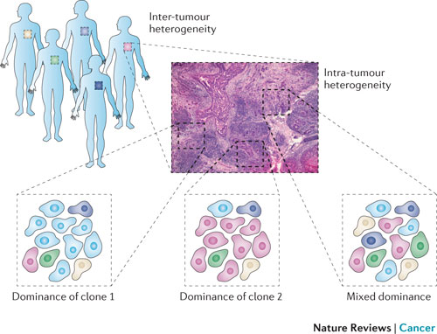
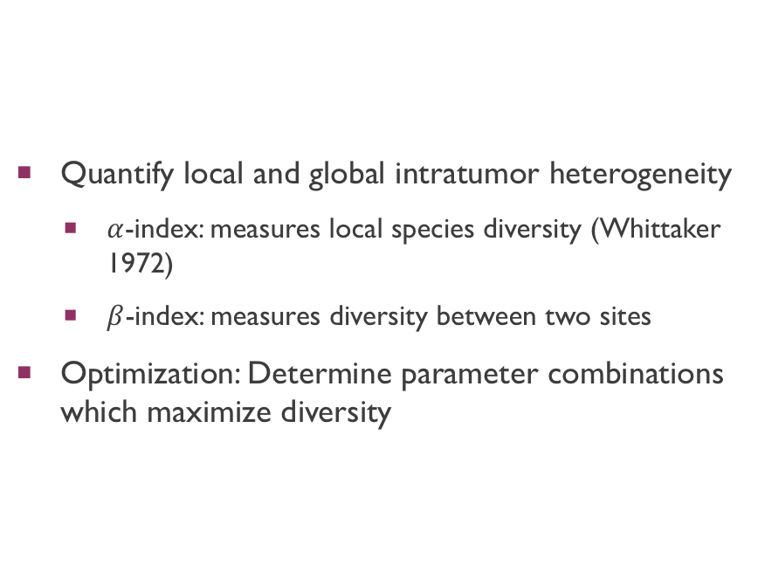
Next Steps
Quantify local and global intratumor heterogeneity
  $α$-index: measures local species diversity (Whittaker 1972)
  $β$-index: measures diversity between two sites
Optimization: Determine parameter combinations which maximize diversity

Slide 10



Acknowledgements
This research is conducted as part of a Research Experiences for Undergraduates (REU) program held at the Center for Discrete Mathematics and Theoretical Computer Science (DIMACS) and was funded by NSF grant CCF-1559855. Lazaros Gallos, Parker Hund, Peter Korcsok, and many others coordinated the REU program. Special thanks to Dr. Subhajyoti De for his mentorship and guidance.

Slide 11
References
American Cancer Society. Cancer Facts & Figures 2018. Atlanta: American Cancer Society; 2018.
Choi, T., Maruya, M. R.,, Tartakovsky, D. M., & Subramaniam, Subramaniam, S. (2012). Stochastic operator-splitting method for reaction-diffusion systems. Journal of chemical physics, 137(18), 184102.
Erban, Radek et al (2007). A Practical Guide to Stochastic Simulations of Reaction-Diffusion Processes. https://arxiv.org/abs/0704.1908
Whittaker, R. H. (1972). Evolution and Measurement of Species Diversity. Taxon, 21(2/3), 213. doi:10.2307/1218190
World Health Organization. Cancer. Atlanta: World Health Organization; 2018. www.who.int/news-room/fact-sheets/detail/cancer

