Slide 1
Nucleosome Packing
Tim Stavetski

Slide 2
How does DNA compact itself?
https://www.oist.jp/news-center/photos/diagram-chromatin-nucleosome-structure
Notes:
https://www.oist.jp/news-center/photos/diagram-chromatin-nucleosome-structure

Slide 3
How do Nucleosomes pack together?
Look at experimental evidence
Run simulations using parameters such as electrostatic forces, elastic properties of DNA
Look at Crystals
http://science.sciencemag.org/content/344/6182/376.full
Notes:
http://science.sciencemag.org/content/344/6182/376.full

Slide 4
How do Nucleosomes pack together?
Look at experimental evidence
Run simulations using parameters such as electrostatic forces, elastic properties of DNA
Look at Crystals
http://science.sciencemag.org/content/344/6182/376.full
Notes:
http://science.sciencemag.org/content/344/6182/376.full

Slide 5
Crystallography

Slide 6
Crystallography
~ The branch of science concerned with the structure and properties of crystals

Slide 7
Crystallography
~ The branch of science concerned with the structure and properties of crystals
~ Take a nucleosome, find conditions under which it will crystalize
~ Describe and analyze the resulting crystal’s structure

Slide 8
Crystallography
~ The branch of science concerned with the structure and properties of crystals
~ Take a nucleosome, find conditions under which it will crystalize
~ Describe and analyze the resulting crystal’s structure

Slide 9
Crystal Structure

Slide 10
Crystal Structure
  Asymmetric Unit- Smallest unit that can generate unit cell through the symmetries found in the crystal lattice

Slide 11
Crystal Structure
  Asymmetric Unit- Smallest unit that can generate unit cell through the symmetries found in the crystal lattice
  Unit Cell- Smallest repeating unit having the same symmetries as the lattice that can generate the whole lattice through only translations

Slide 12
Crystal Structure
  Asymmetric Unit- Smallest unit that can generate unit cell through the symmetries found in the crystal lattice
  Unit Cell- Smallest repeating unit having the same symmetries as the lattice that can generate the whole lattice through only translations

Slide 13
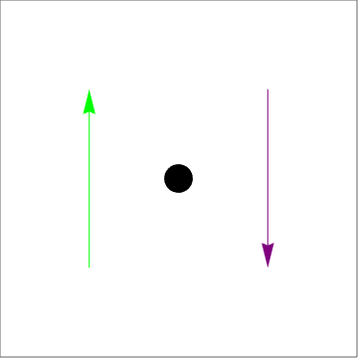
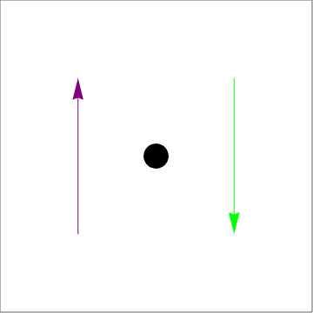
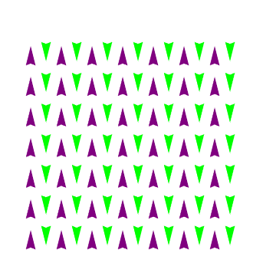

Slide 14
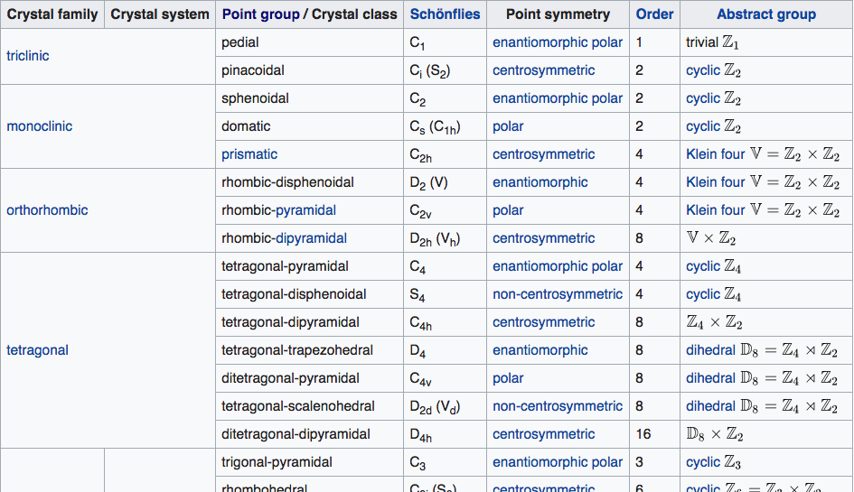

Slide 15
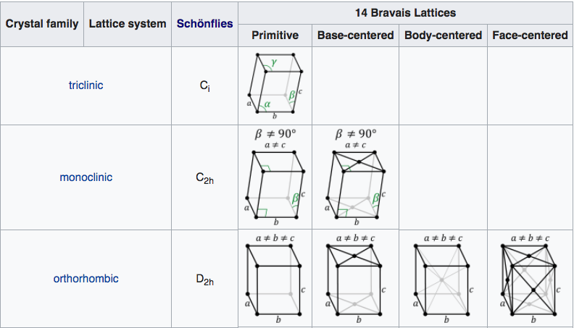

Slide 16
Protein Data Bank

Slide 17
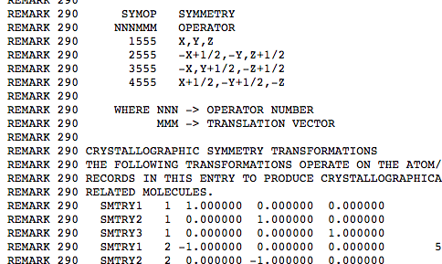
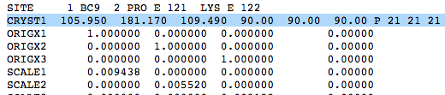
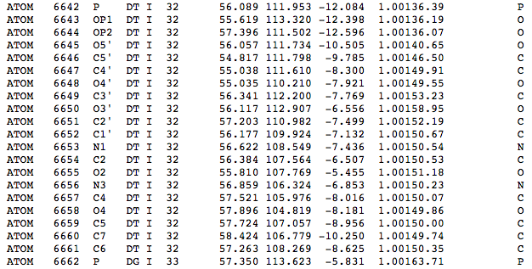
Protein Data Bank

Slide 18
Implementation
$$\left[\begin{aligned}n_{i,j}\end{aligned}\right]=$$
Transformation Matrix
$$(x,y,z)=$$
Atom Coordinates
$$\left[\begin{aligned}a \\ b \\ c\end{aligned}\right]=$$
Unit Cell Dimensions
$$\left[\begin{matrix}n_{1,1} & n_{1,2} & n_{1,3} \\ n_{2,1} & n_{2,2} & n_{2,3} \\ n_{3,1} & n_{3,2} & n_{3,3}\end{matrix}\right]\left[\begin{aligned}x \\ y \\ z\end{aligned}\right]+c\left[\begin{aligned}a_{1} \\ a_{2} \\ a_{3}\end{aligned}\right]$$

Slide 19
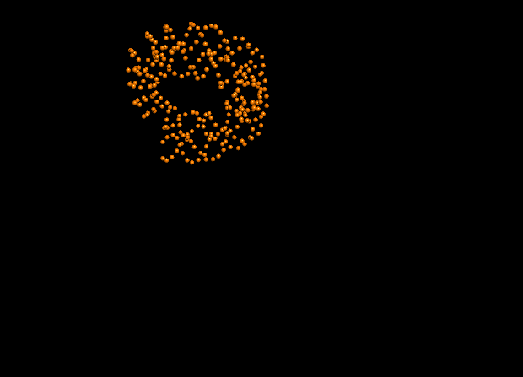
Asymmetric Unit

Slide 20
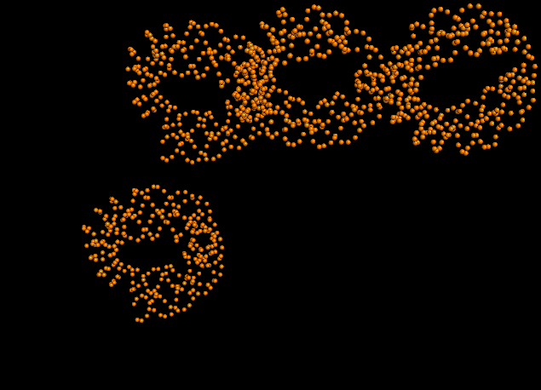
Generating Symmetry Mates

Slide 21
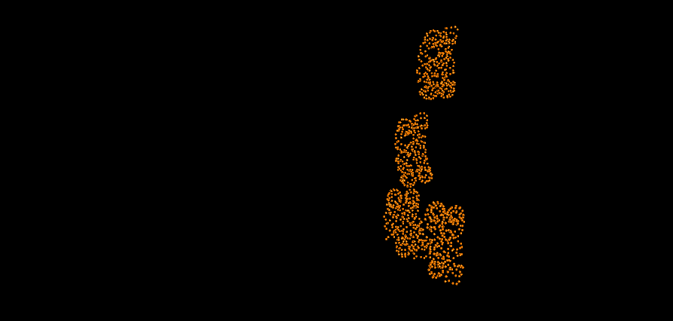

Slide 22
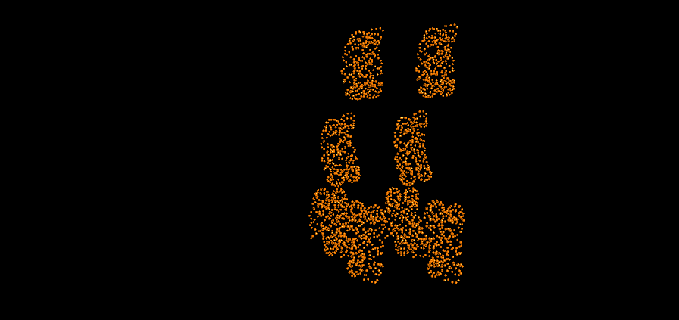

Slide 23
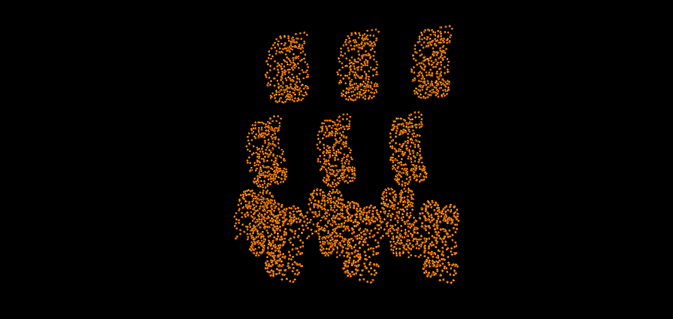

Slide 24
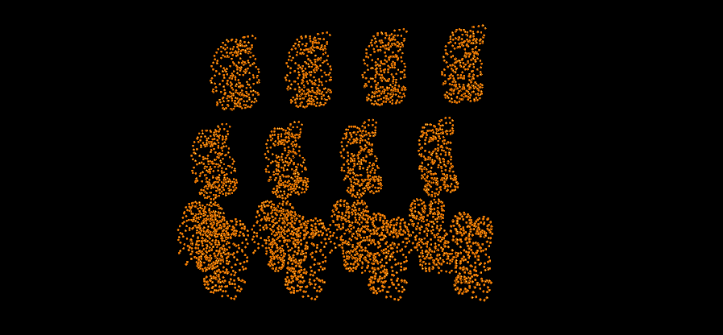

Slide 25
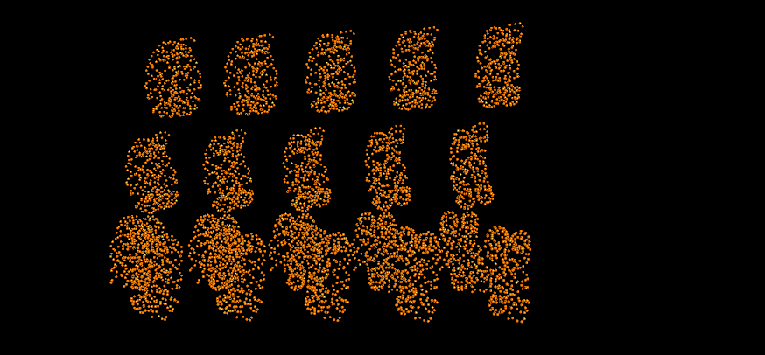

Slide 26
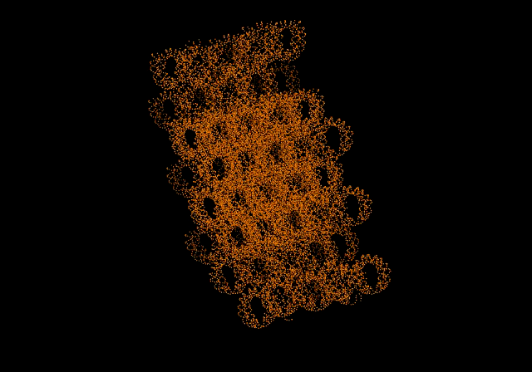

Slide 27
What if unit cell isn’t orthogonal?
$$α,β,γ≠{90}^{o}$$
C
B
A

Slide 28
Implementation
Given:
$$a,b,c,α,β,γ$$
C
$$A=\left[\begin{aligned}a \\ 0 \\ 0\end{aligned}\right]$$
$$B=\left[\begin{aligned}bcos(γ) \\ bsin(γ) \\ 0\end{aligned}\right]$$
$$C=\left[\begin{aligned}ccos(β) \\ \\ \frac{c\left(cos(α)-cos(α)cos(γ)\right)}{sin(γ))} \\ \\ \sqrt{c^{2}-ccos(β)-\frac{c\left(cos(α)-cos(α)cos(γ)\right)}{sin(γ))}}\end{aligned}\right]$$
B
A
Notes:
http://xray0.princeton.edu/~phil/Facility/Guides/unitcell.jpg

Slide 29
Implementation
$$\left[\begin{aligned}n_{i,j}\end{aligned}\right]=$$
Transformation Matrix
$$(x,y,z)=$$
Atom Coordinates
$$A,B,C=$$
Unit Cell Vectors
$$\left[\begin{matrix}n_{1,1} & n_{1,2} & n_{1,3} \\ n_{2,1} & n_{2,2} & n_{2,3} \\ n_{3,1} & n_{3,2} & n_{3,3}\end{matrix}\right]\left[\begin{aligned}x \\ y \\ z\end{aligned}\right]+c_{1}A+c_{2}B+c_{3}C$$

Slide 30
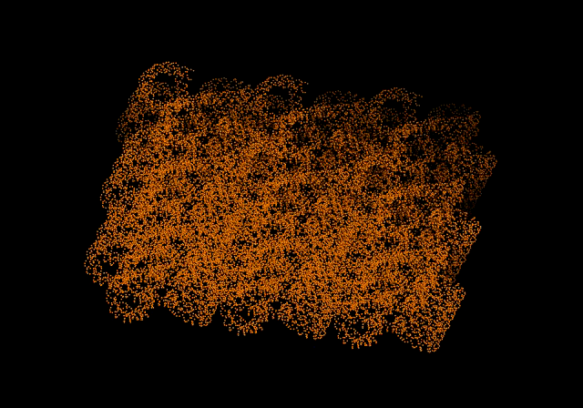

Slide 31
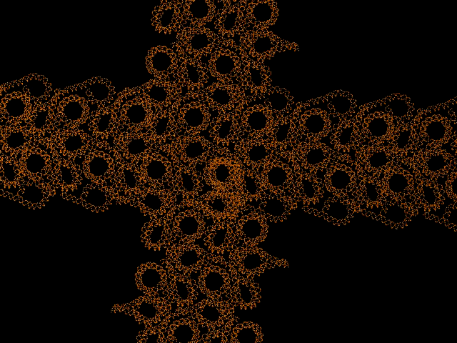

Slide 32
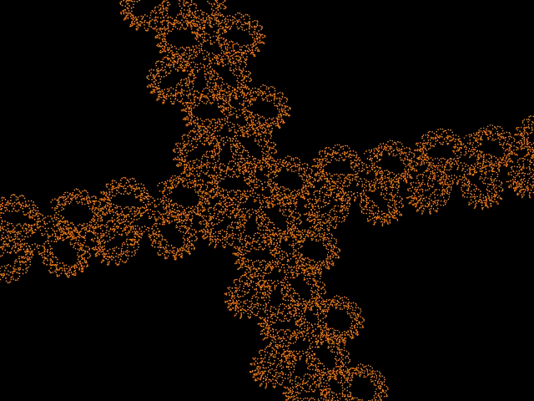

Slide 33
- Make python script more robust
- Be able to generate symmetry mates with unique interactions
- Relate crystal symmetry back to six rigid body parameters
Final Weeks

Slide 34
Thank you
~ To the NSF for the funding of my research
~ Dr. Olson, and the whole lab for mentoring me this summer
~ Dr. Gallos, Parker, and whole DIMACS Staff for running this program

Slide 35
Citations
Cryo-EM Study of the Chromatin Fiber Reveals a Double Helix Twisted by Tetranucleosomal Units
BY FENG SONG, PING CHEN, DAPENG SUN, MINGZHU WANG, LIPING DONG, DAN LIANG, RUI-MING XU, PING ZHU, GUOHONG LI
SCIENCE25 APR 2014 : 376-3

