Slide 1
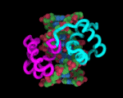
Levenshtein distance and siRNA
An algorithm for determining functional siRNA

Slide 2
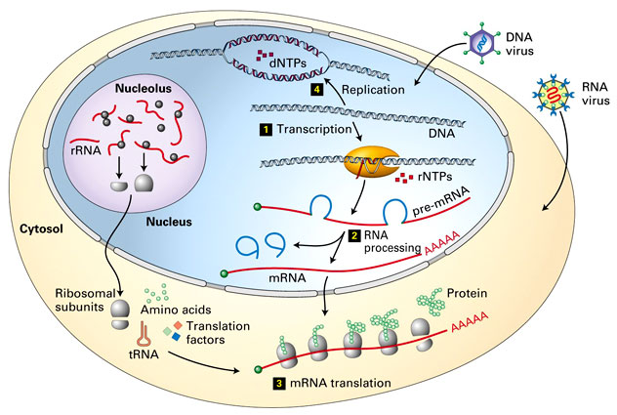
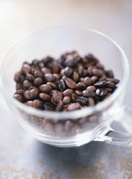
What is siRNA? http://fig.cox.miami.edu/~cmallery/255/255hist/mcb4.1.dogma.jpg http://www.nature.com/news/2003/030616/full/030616-12.html
Short-interfering RNA
Interferes with mRNA
  Inhibits specific proteins from being produced
How proteins are made
  Transcription
    DNA RNA
  Translation
    mRNA protein
  Protein!
Some proteins we would like to suppress
  Ex: Knocked out caffeine genes in coffee plants.

Slide 3
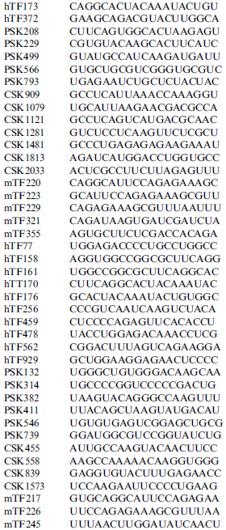

The Problem…
Which strings of siRNA effectively silence genes?
Too many to test every single one
Tried combinatorics
  Results: About 25% of all strings (of 20 nt strands) fit ideal properties of functional siRNA
  BUT this amounts to about
  274,877,907,000
  strings…
Notes:
http://www.tidewaterbusinessservice.com/Smiley%20confused.jpg
Confused smiley

Slide 4
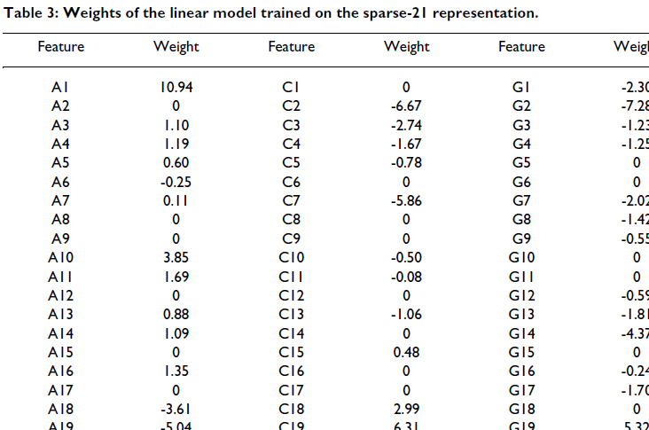
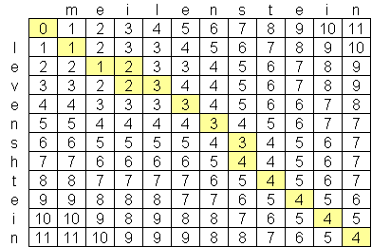
Levenshtein Distance
1. Vert JP, Foveau N, Lajaunie C, Vandenbrouck Y: “An accurate and interpretable model for siRNA efficacy prediction”. BMC Bioinformatics. 2006, 7:520.
Levenshtein Distance
  Calculate distance between strings based on whether character n in string1 is the same as character n in string2.
  Minimum number of substitutions/insertions required to transform one string to another.
Modifications
  Used weights from Vert’s paper¹
    Each substitution no longer increments distance by uniform amount
  Depends on
    Position of nucleotide substitution
    Type of substitution

Slide 5
Modified algorithm
2. http://sirecords.umn.edu/siRecords/download_data.php
Algorithm
  C++ implementation
Data
  Data downloaded from siRecords²
  Used only data for siRNA targeting HEK (human embryonic kidney) mRNAs.
  Four levels of efficacy
    4=Very High
    3=High
    2=Medium
    1=Low
…UCCAUAGUAG…
…AACGUUCGGU…
1. Position of nucleotide
2. Type of nucleotide substitution

Slide 6
Results
25 splits of the HEK data
61 total functional strings (efficacy = 1)
120 total nonfunctional strings (efficacy = 4)
Average accuracy
Functional: 67.6%
Nonfunctional: 65.0%
Data splitting
Matlab algorithm to randomly split data into training and test sets
30 functional training
60 nonfunctional training

Slide 7
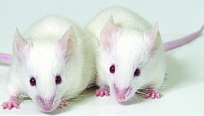

Issues with the algorithm
Vert’s weight data is collected from both murine and human sources

Slide 8
Future Work
Incorporate thermodynamic data from Vert into algorithm for additional accuracy

Slide 9
Acknowledgements

